Slide 1
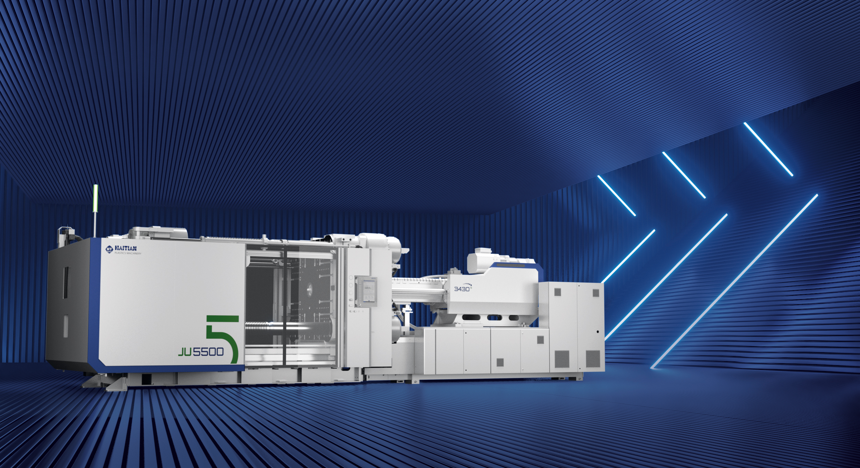



JUPITER SERIES
SERVO HYDRAULIC
TWO-PLATEN SOLUTION
4,500 – 88,000 kN
JU

Slide 2

Research & Development
1997
2003
2007
2012
2015
Two-Platen Machine
Research Phase
HTK
Two and a half platen
General Motor
JU
Two and a half platen
Servo Motor
J5 Control System
JUII
Two-Platen
Servo Motor
J5 Control System
Early development of Haitian two-platen machine: servo motor and J5 card make Haitian second board machine become energy-saving (analog communication) injection molding machine
1997
2012

Slide 3

Research & Development
2015
2019
2020
2023
First order for 8800T injection molding machine
JUIIS
Two-Platen
Tier bar suspension
Servo Motor
J5 Control System
JUIII
Two-Platen
Tier bar suspension
Servo Motor
J6 Control System
JUSE
More in line with domestic and foreign customers use habits
JUV
Two-Platen
Tier bar suspension
Servo Motor
J6 Control System
HT Injection Molding Machine
Haitian second board machine sales and reputation continue to rise
Start converting to digital volume communication (J6 card)
2015
2023

Slide 4
Machine Range & Combinations
Clamping
Unit
Injection
Unit
Standard
Combination range
 | 1750 | 2250 | 3450 | 4650 | 5350 | 6750 | 8950 | 11500 | 17500 | 22500 | 32500 | 40500 | 50500 | 62500 | 93500 | 106500 | 202500
4500
5500
6500
7500
9000
10800
12000
13000
14000
16000
18500
21000
24000
28000
33000
40000
55000
66000
88000

Slide 5

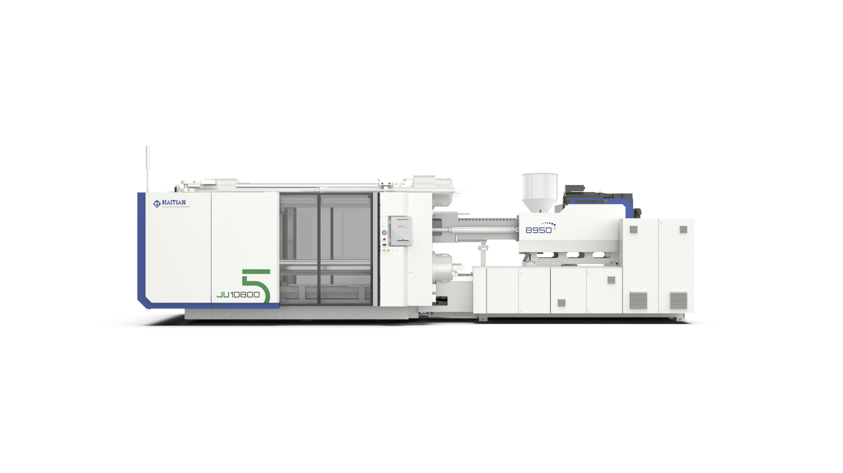
Introducing HT·XTEND
Hardware Design
The new Standard in
Injection Molding through
Smart Machine Technology
Control Technology
Communication Technology
AI Algorithms
Sensor Technology

Slide 6

Introducing HT·XTEND
Greater flexibility in production
Increased Output with reduced costs
Real-time Monitoring
Improved Precision and
Quality Control
HT•XTEND
Enhanced Safety and Monitoring
AI-driven optimization
Adaptive control systems
Cost Reduction and ROI
Adaptability to
New Materials
Minimizing downtime &
maintenance expenses
Energy Savings and Sustainability

Slide 7





HT•XTEND
HT·CLAMP
HT·DIAGNOSE
HT·INJECT
HT·ENERGY
Smart Machine Technology as a
Standard
HT·CHARGE
HT·LUBRICATE
Notes:
Add HT Inject

Slide 8
Overview Haitian Jupiter Series
HT Clamp
Correcting algorithm for accurate mold opening and positioning, stable and fast movement
Large mold space
Mold transfer stroke, ejection stroke and layout are highly expandable
HT Energy
Smart energy consumption
monitoring and auxiliary
management via HMI
Resistant Plasticizing Unit
Strong performance with high wear resistance of plasticized parts (doubled compared G3)
Electrical charging
Improves plasticizing speed and quality, while reducing energy consumption of the entire process
(optional for models with injection equivalent of 11,500 and above)
Small Footprint
The whole machine has a compact structure and high utilization rate of floor space
HMI
Large-screen control panel and UI design make for fast and intuitive interaction with machine
Intelligent diagnosis and assistance
Graphical digital bus topology, quickly locate fault nodes and determine the cause of the fault.
High-response servo system
Tailor-made servo power system, high-speed response, dynamic sensitivity, and strong power.
Accurate temperature monitoring
The oil temperature is accurate, the process status is stable, the blanking temperature is accurate, the material storage is stable, and the whole machine operates more stably.

Slide 9
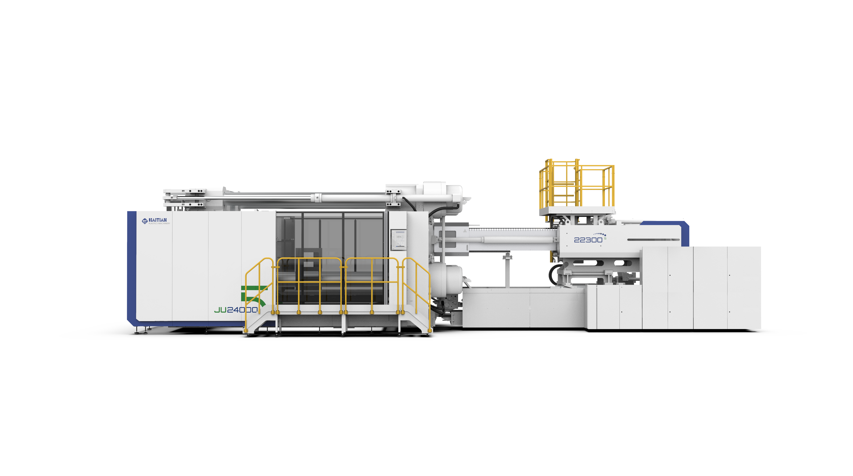
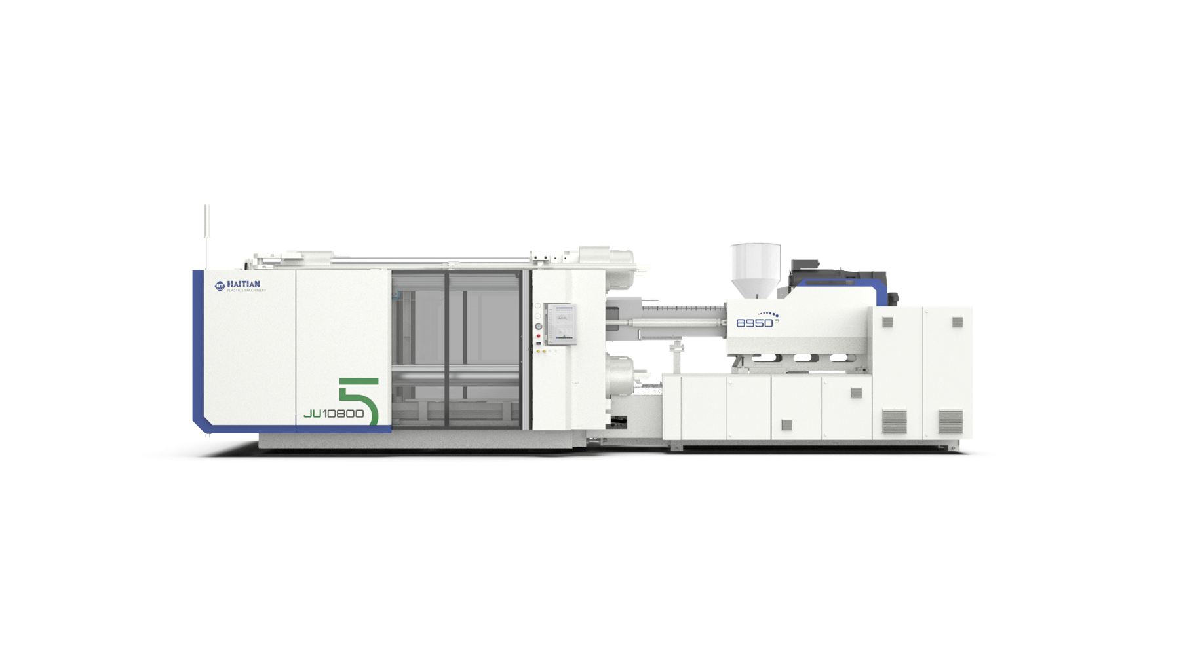
Overall Appearance
4500
5500
6500
7500
9000
10800
12000
13000
14000
16000
18500
21000
24000
28000
33000
40000
55000
66000
88000
kN
JU4500V – JU7500V
JU9000V - JU55000V
Standard protection door
Floor type protection door

Slide 10
Compact overall structure
The compact structure of the whole machine, the floor area is reduced by more than 10%, especially for the large and medium-sized injection molding machine, the demand space is further reduced, the plant utilization rate is greatly improved, and the factory operating costs are reduced.
 | Width |  | Length |  | Site area comparison
 | JUIII | JUV | JUIII | JUV
450 | 2168 | 2168 | 6866 | 6755 | -1.62%
1080 | 3301 | 3040 | 9610 | 9302 | -10.86%
1850 | 4148 | 3754 | 12277 | 11911 | -12.20%

Slide 11
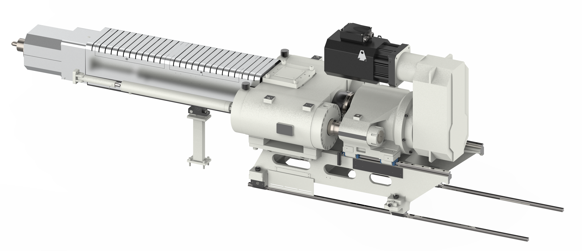
INJECTION UNIT
Dual-cylinder balanced injection system
Double-Layer Linear Guide Structure
Barrel Support Device
Screw Barrel
Energy-Saving Thermal Insulation Device
Full Closed Loop Injection
HT Inject
Material Leakage Detection
Electrical Charging
Easy Maintenance
HT•XTEND

Slide 12
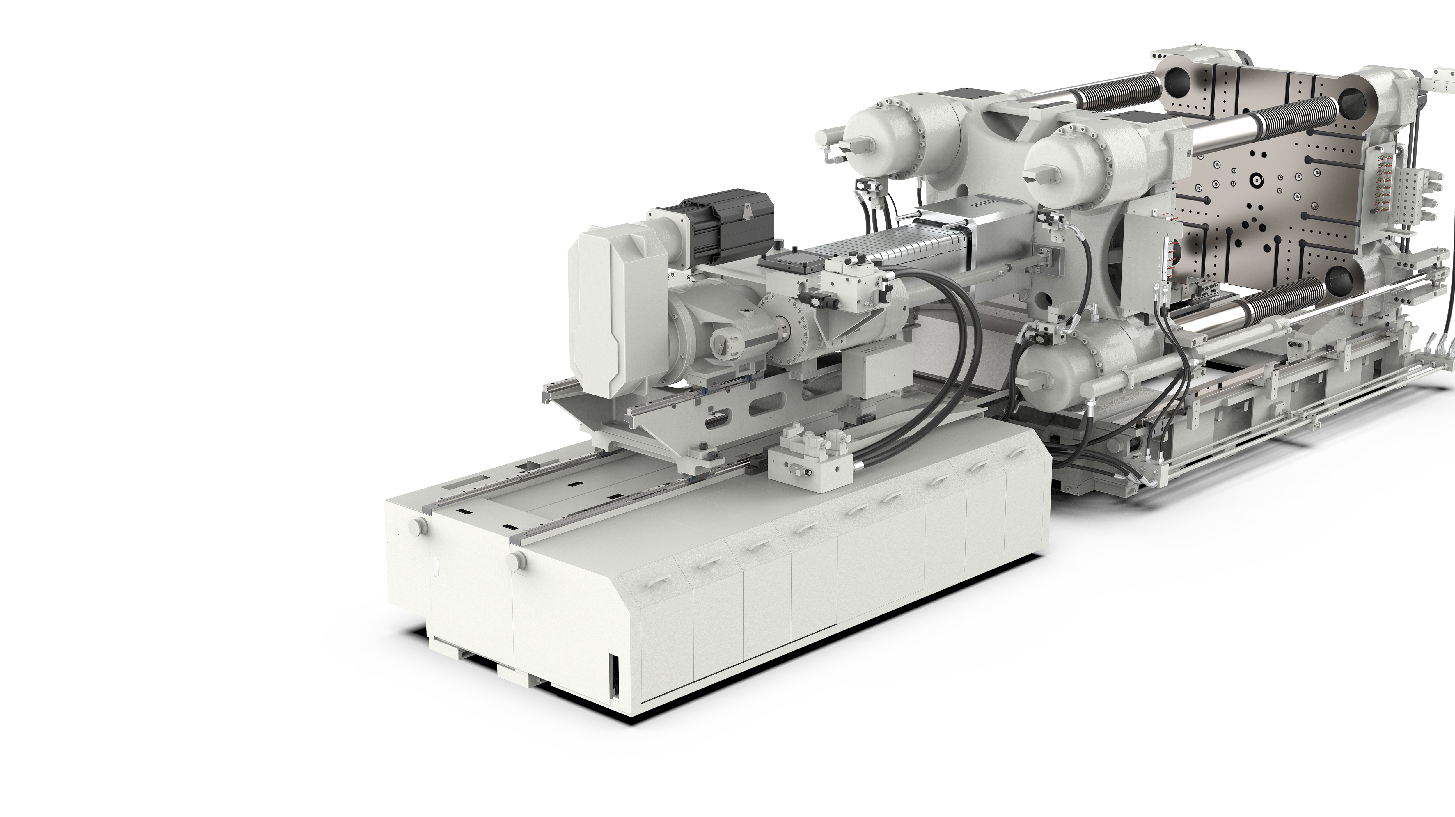


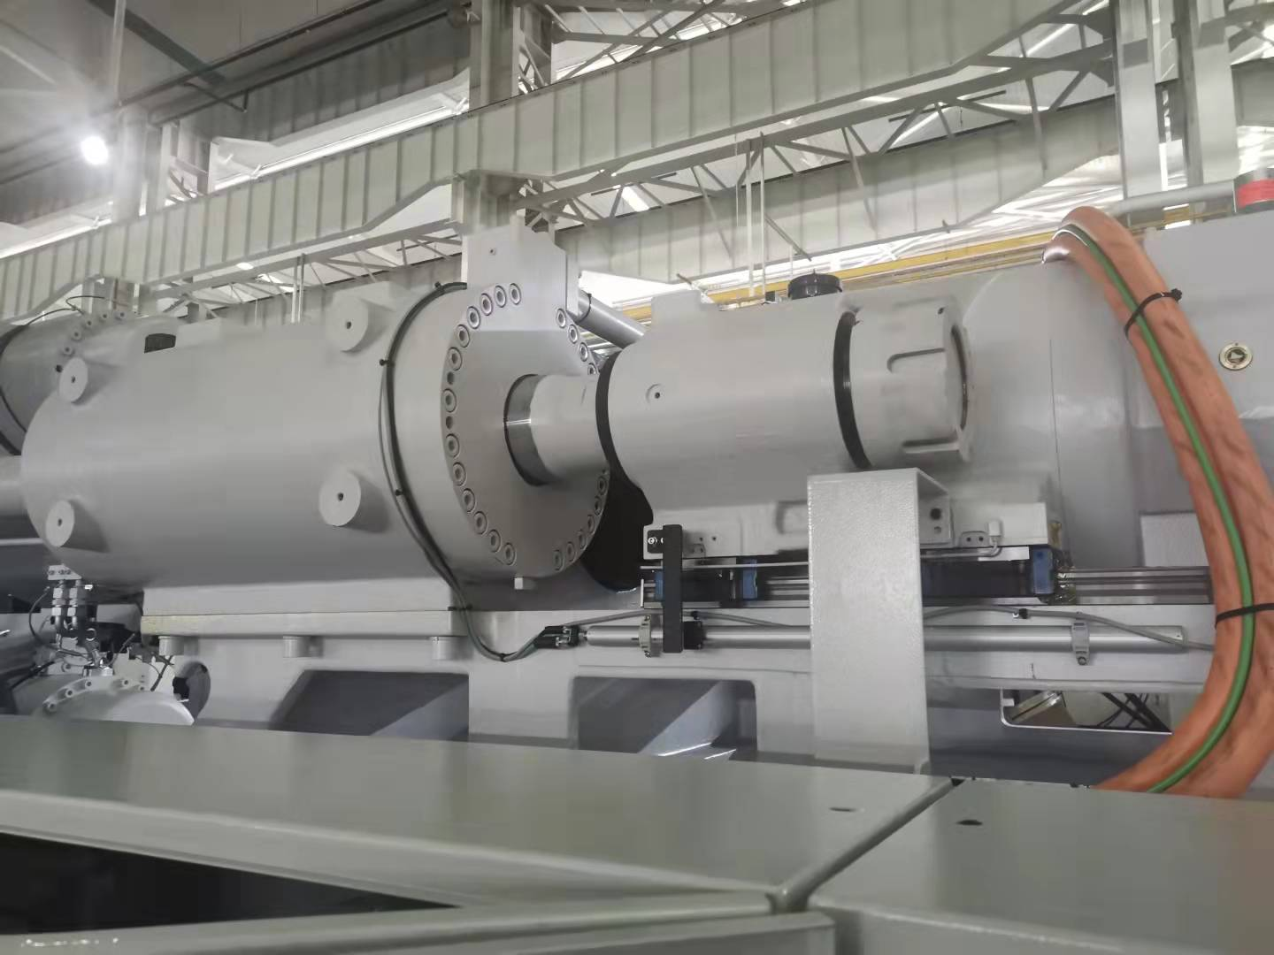
Dual-cylinder balanced injection system
High rigidity balanced dual-cylinder structure design
Modular system
Injection cylinder special design, differential injection
Faster injection speed
Guarantee low speed stability

Slide 13
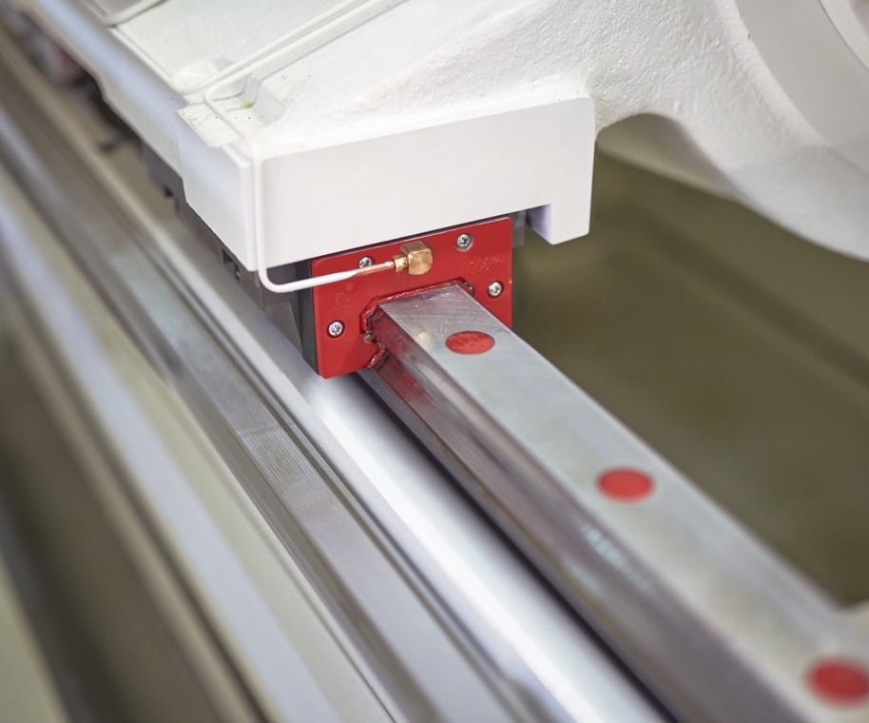
Double-layer Linear Guide Structure
Linear guide rails are used for integral movement and injection
Low friction coefficient
Low injection inertia
High injection precision

Slide 14
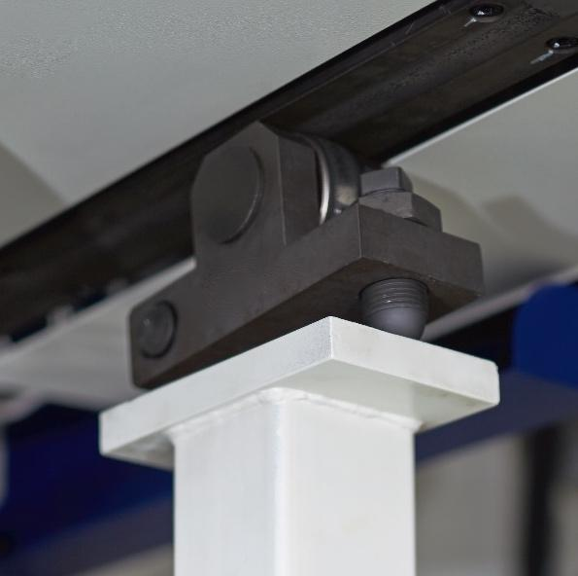
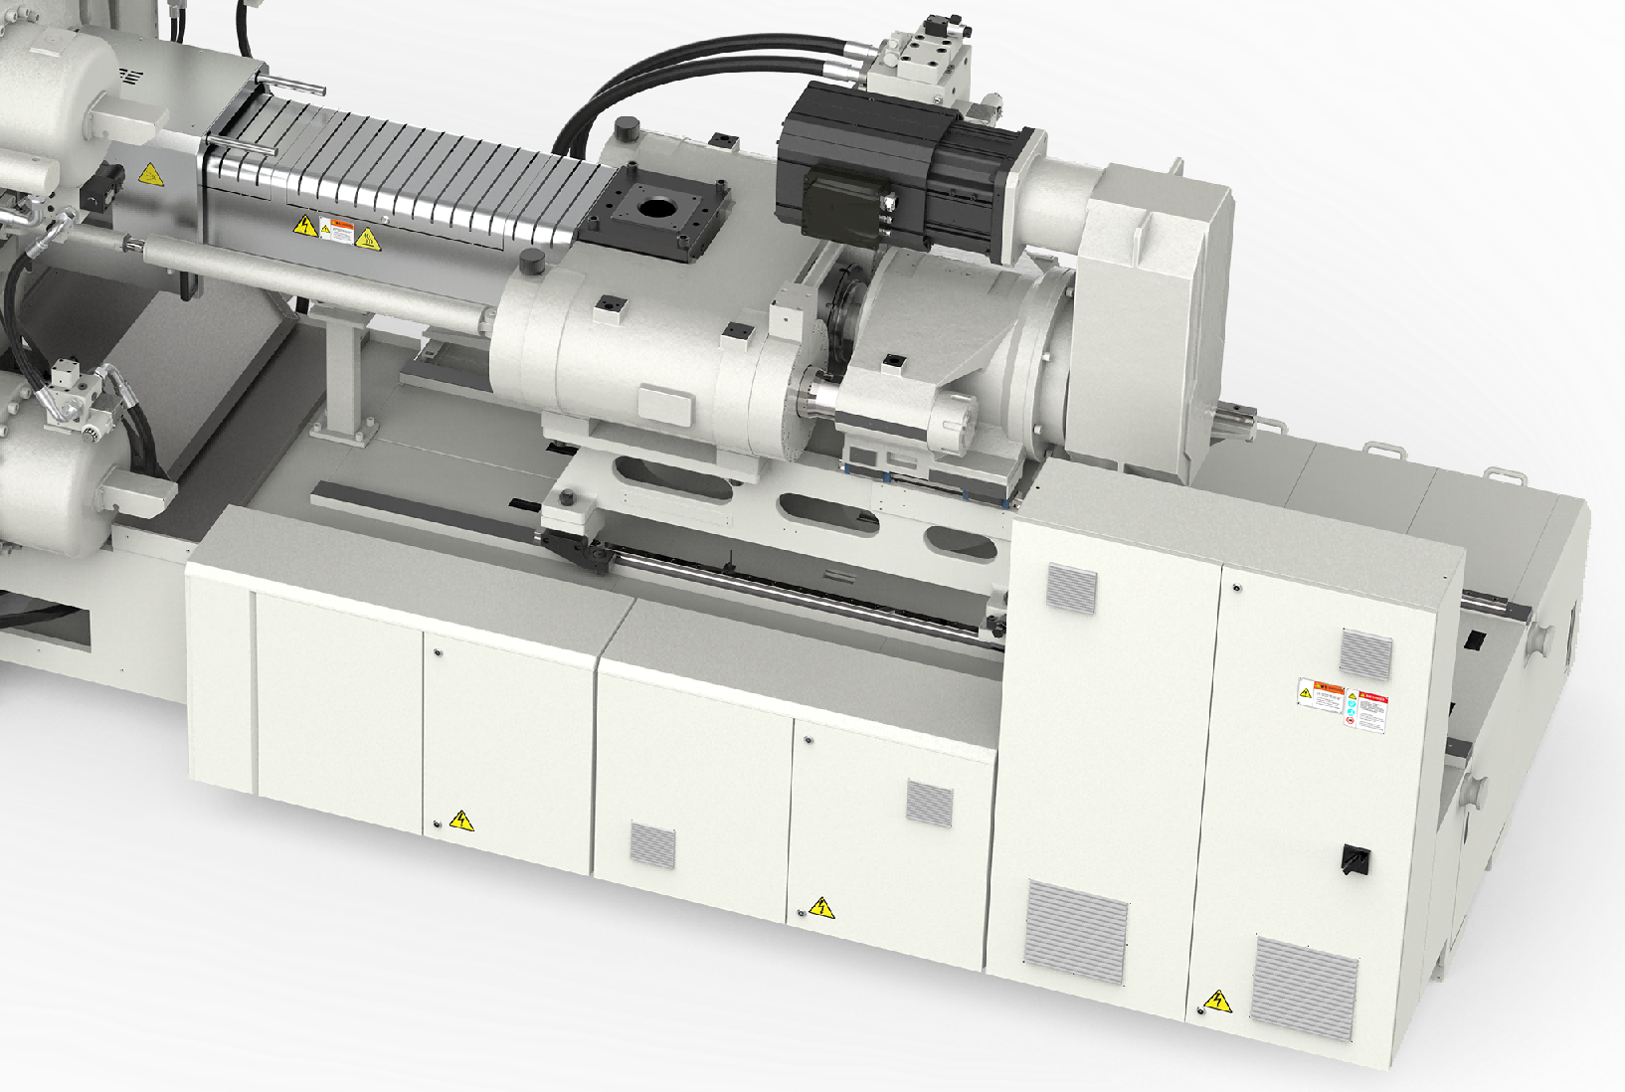
Barrel Support Device
Easy to adjust
Convenient for fine tuning

Slide 15
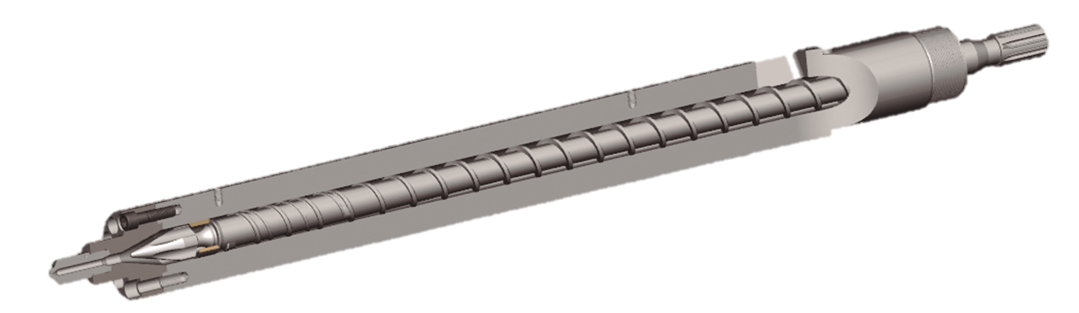
Screw Barrel
Standard universal bimetal screw bimetal K1 barrel
450t-550t：ABC
G-type bimetal screw nitriding barrel
2400t and above
Variable pitch bimetal screw bimetal K1 barrel
1300t-1400t：CD
650t-2100t：C
G-type bimetal screw bimetal K1 barrel
Variable pitch chrome plated screw bimetal K1 barrel
Longer Service life
2100t: D
650t-2100t：AB

Slide 16
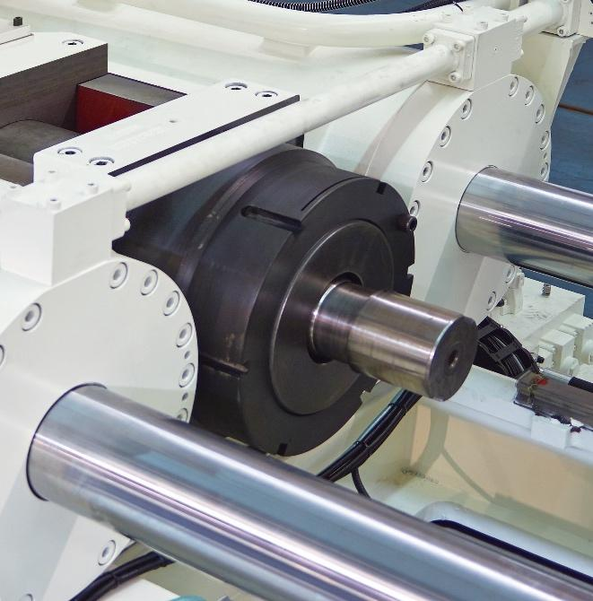
Screw Barrel Removal
Rapid screw barrel change design (11,500 injection equivalent and above)

Slide 17

Energy-saving thermal insulation device
Double barrel shell structure, removable energy-saving insulation structure design, effectively improve the heating and insulation effect

Slide 18
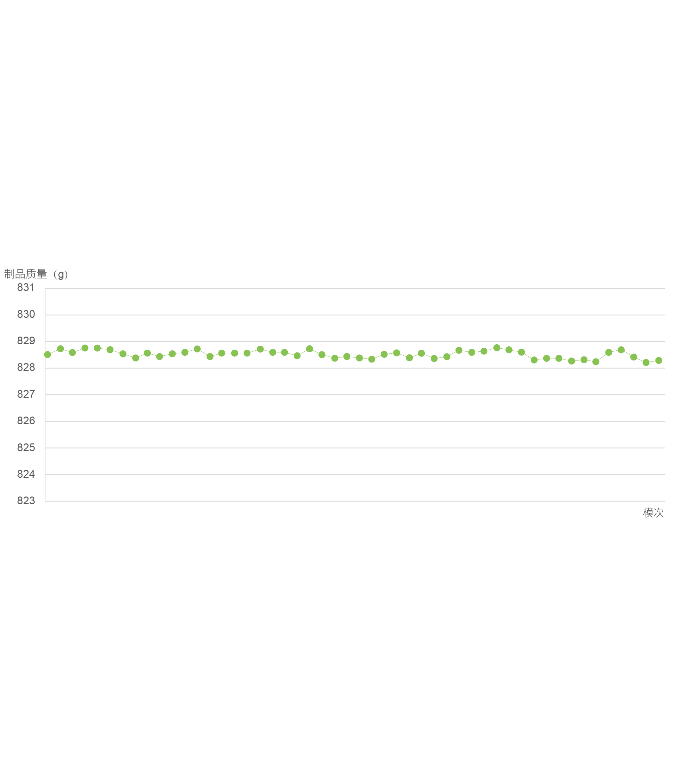
Injection fully closed loop
Product weight (g)
High precision and repeatability
Fast response
Stability also at low injection-speeds
Process adaptability
Consistent product quality
Shots

Slide 19
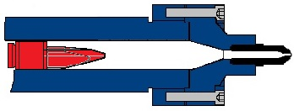
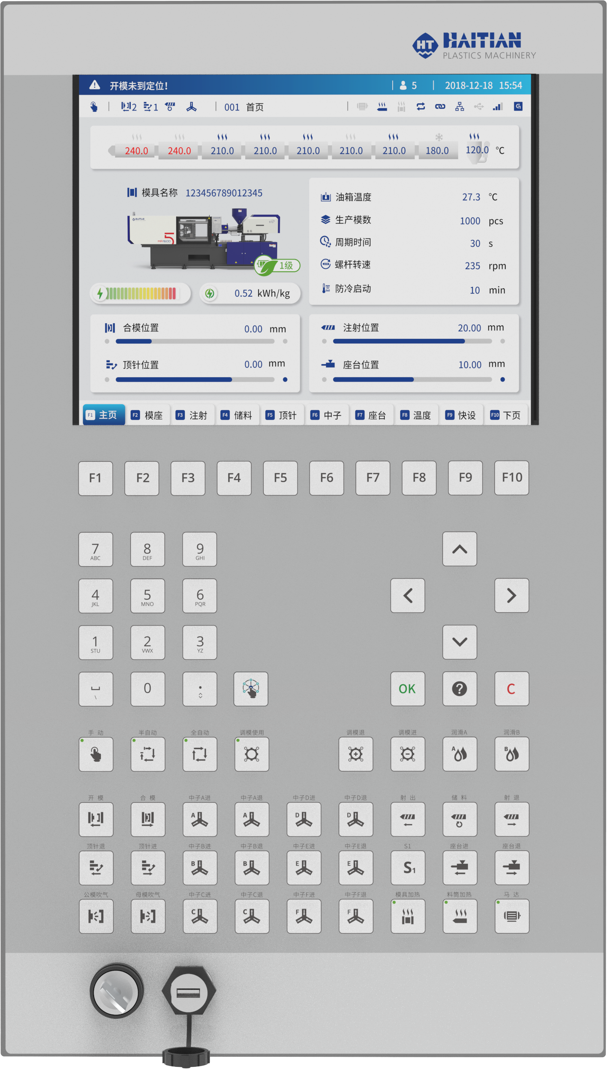
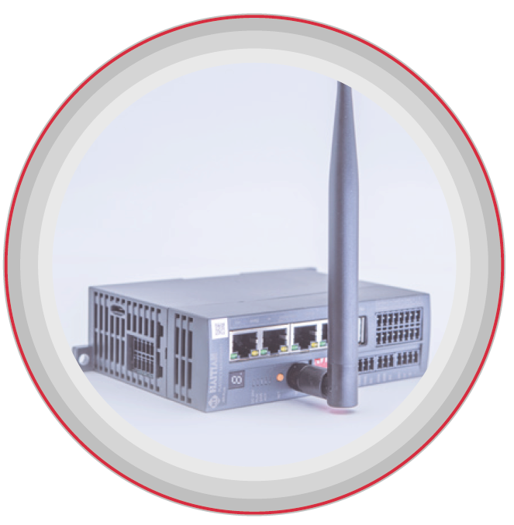
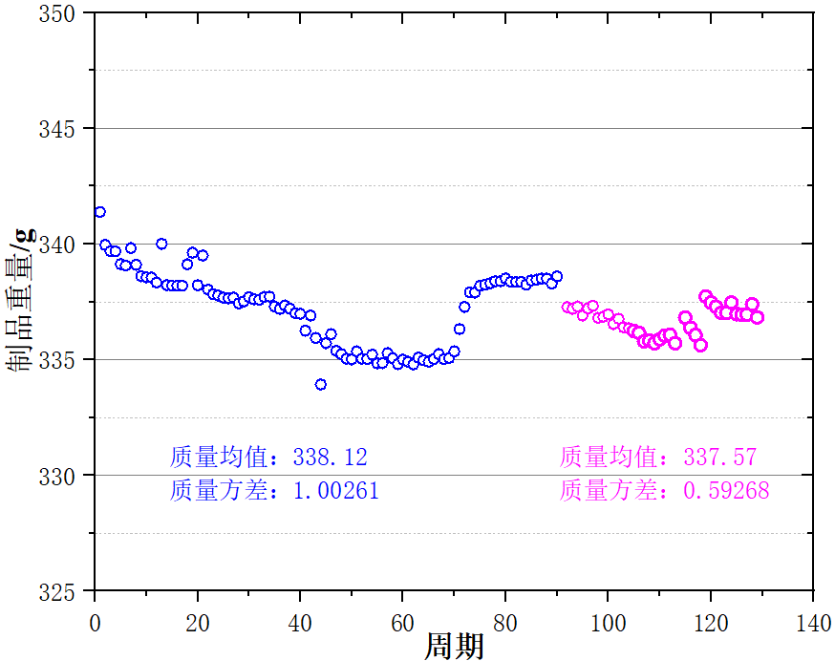
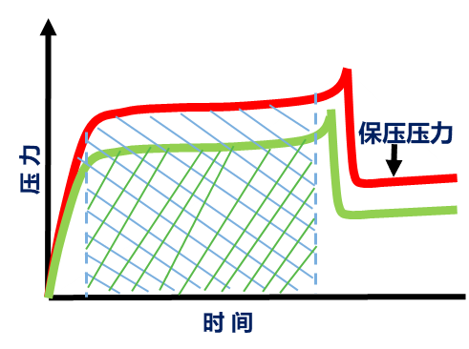
HT Inject
Mechanical control output
Improving weight stability of injection molded products
Some disturbance factors in the injection filling process are controlled in real time to achieve the weight stability control goal of the injection product
HT Inject
Close
Open
Product weight (g)
Pressure
Holding
Data processing
Average:
Average:
Key Algorithm
Variance:
Variance:
Time
Cycle time

Slide 20
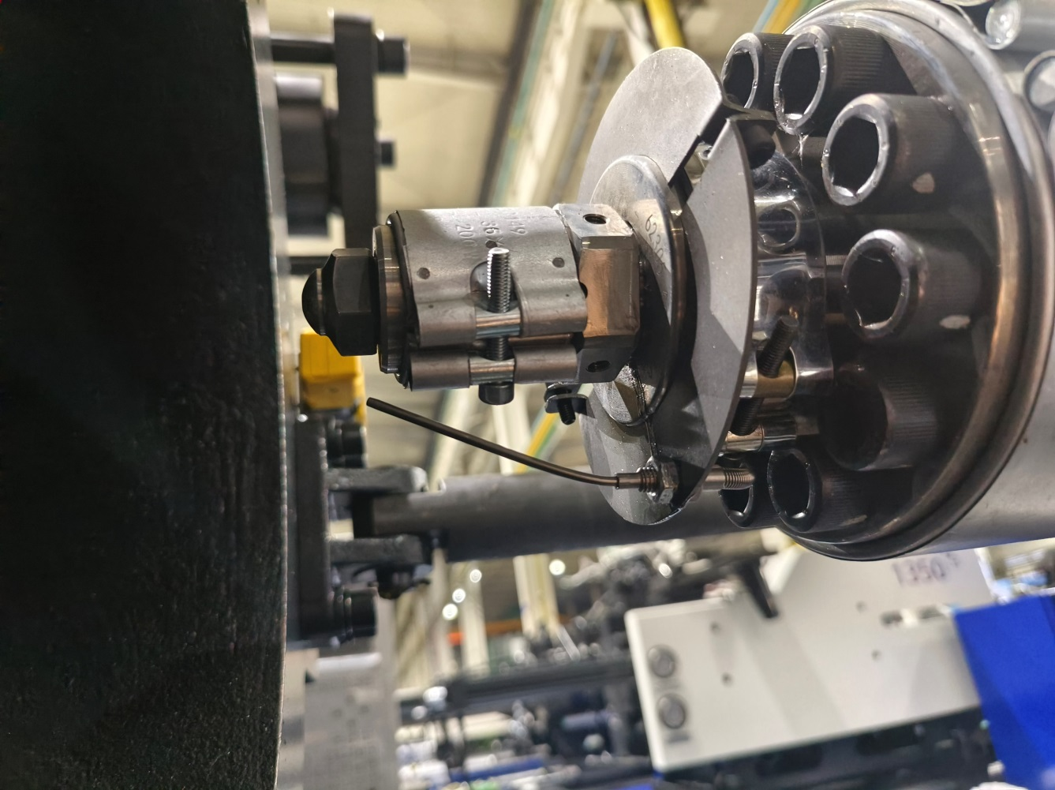
Material Leakage Detection
When the nozzle contact surface leakage to the detection switch, and the computer read the temperature and time to a certain range, the machine will alarm, customers can choose use or not.

Slide 21
Electrical Charging
Standard Electricity Charging For Some Models
Low speed fluctuation, stable storage, high precision
Reduce noise
Standard electricity charging , using a single driver switch control of charging motor and system motor, without mold opening and closing, charging linkage function
↓
15%
Plasticizing Efficiency
Standard electricity charging
Optional electricity charging
20% +
↓
4500kN
1,200kN
88,000kN
Machine Energy Consumption
More than 30% injection volume

Slide 22

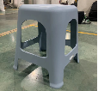
Energy Consumption Comparison
Product production energy consumption comparison
 | JU5500Ⅲ3430 | JU5500V/3450
Machine Code： | 202212055064583 | 202312055011059
Materials： | PP | PP+1%Back Materials
Product Size：mm | 280*280*480*1.5 | 340*340*470*2.2
Mould Size：mm | 760*760*850 | 780*780*830
Product Weight：g | 1342 | 1329
Heating Temperature：℃ | 235 | 260
Mold Opening Distance：mm | 1020 | 1150
Set Mold Locked Force：Ton | 250 | 265
Actual Mold Locked Force：Ton | 257 | 285
Injection Stroke：mm | 304 | 278.6
Charging Back Pressure：bar | 5 | 3 ~ 5
Screw Speed：rpm | 195 | 200

Slide 23
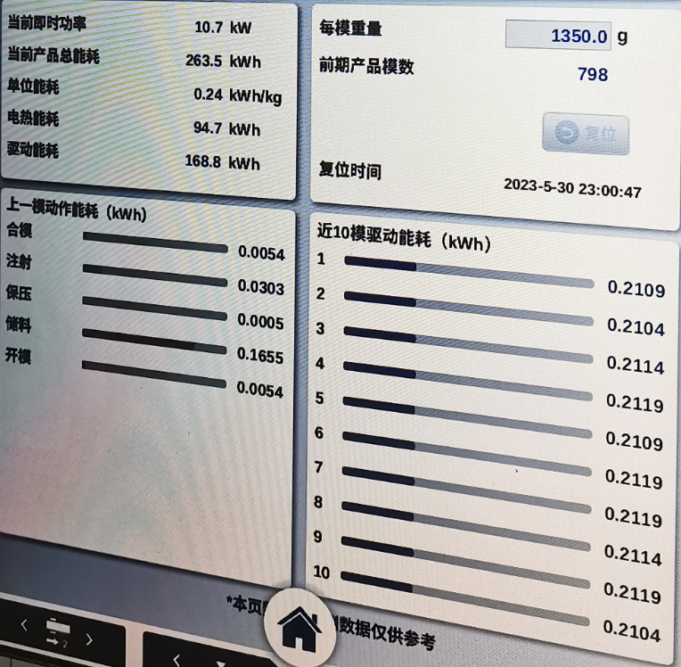
Energy Consumption Comparison
 | JU5500Ⅲ3430 | JU5500V/3450 | percentage
Production cycle of single piece：s | 66.4 | 44.3 | 33%
Time of mold opening and closing：s | 10.95 | 9.3 | 15%
Injection Time：s | 7.3 | 6
Charging Time：s | 24 | 15.5 | 35%
Cooling Time：s | 35 | 19
Time of core out：s | 4 | 3
Parts removal time：s | 9 | 7
Energy consumption（30 times）: kwh | 13.481 | 8.8246
Time（30 times）：s | 1991.8 | 1337
Total weight of product（30 times）：g | 40278 | 39869
Energy consumption：kwh/kg | 0.3347 | 0.2213 | 34%
Actual energy consumption：kwh/kg |  | 0.2533（include chiller） | 24%
Robot | Contain | Contain
Vacuum loader | Contain | Contain
labeler | Contain | Contain
Chiller | None | External Power supply without energy
Theoretical calculation chiller energy consumption：kwh/kg |  | 0.032
The actual energy consumption is very close to estimation.

Slide 24
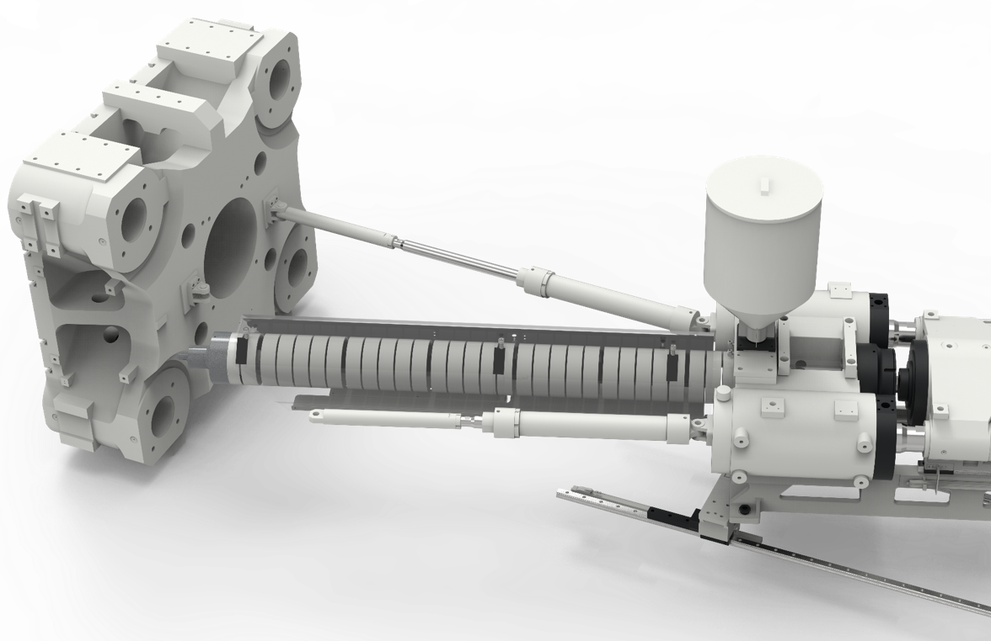
Easy maintenance
Save at least 30% time
The injection unit can be rotated to facilitate the replacement and maintenance of the screw barrel

Slide 25
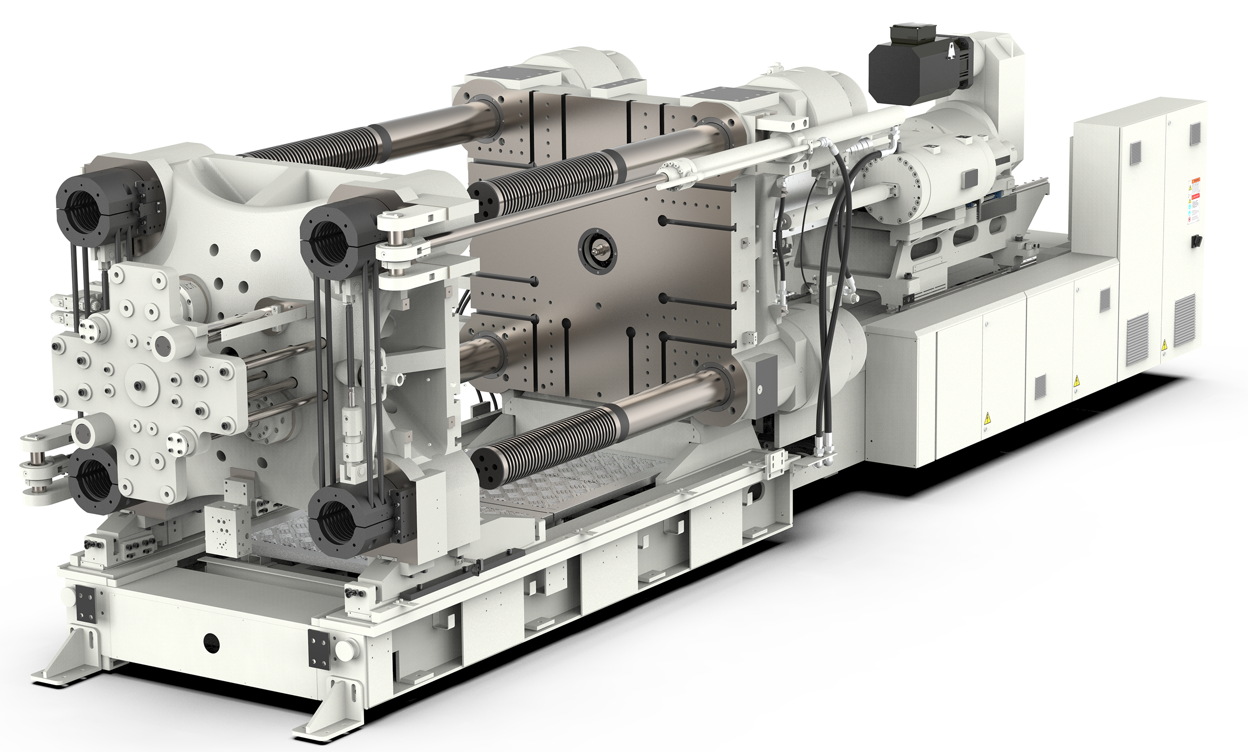
Clamping Unit
Compact overall structure
Clamping cylinder
Lock system
Ejection system
Moving platen support mechanism
Clamping area safety pedal
Tie bar positioning
Lubrication system
HT•CLAMPING 2.0
Custom opening and closing mold proportional valve applications
High opening mold positioning accuracy
Faster cycle times

Slide 26
Compact overall structure
Larger mold space, easier to operate, is the ideal carrier for large and multi-cavity complex molds
Increase the scalability of the device layout and optimize the selection of automation options to bring more available space

Slide 27
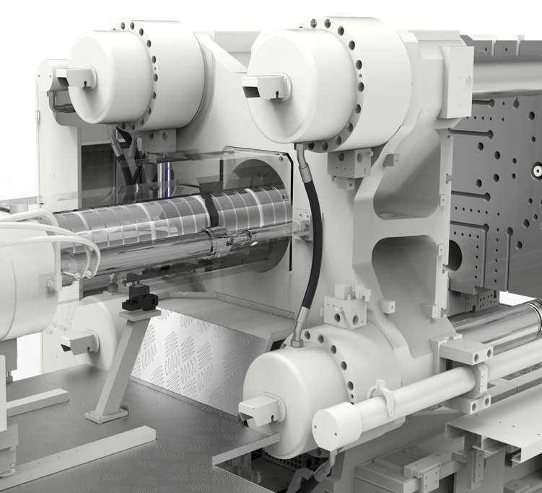
Clamping cylinder
Four short-range clamping cylinders mounted on a fixed form quickly establish clamping forces.
The clamping force can be monitored in real time by the pressure sensor, and the clamping force has good repeatability.
Notes:
No change

Slide 28
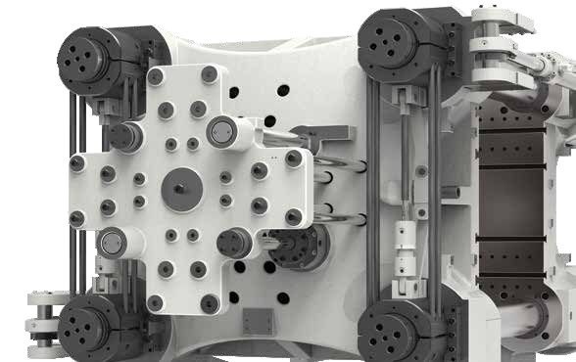
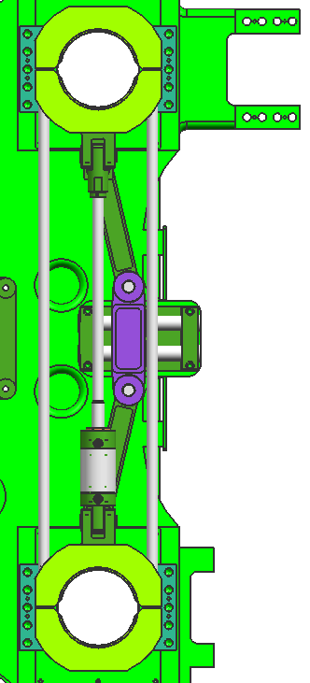
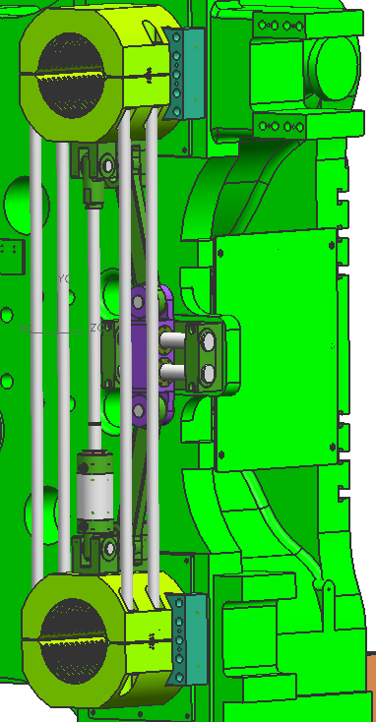
Lock system
Synchronous holding mechanism
Fast and reliable response

Slide 29
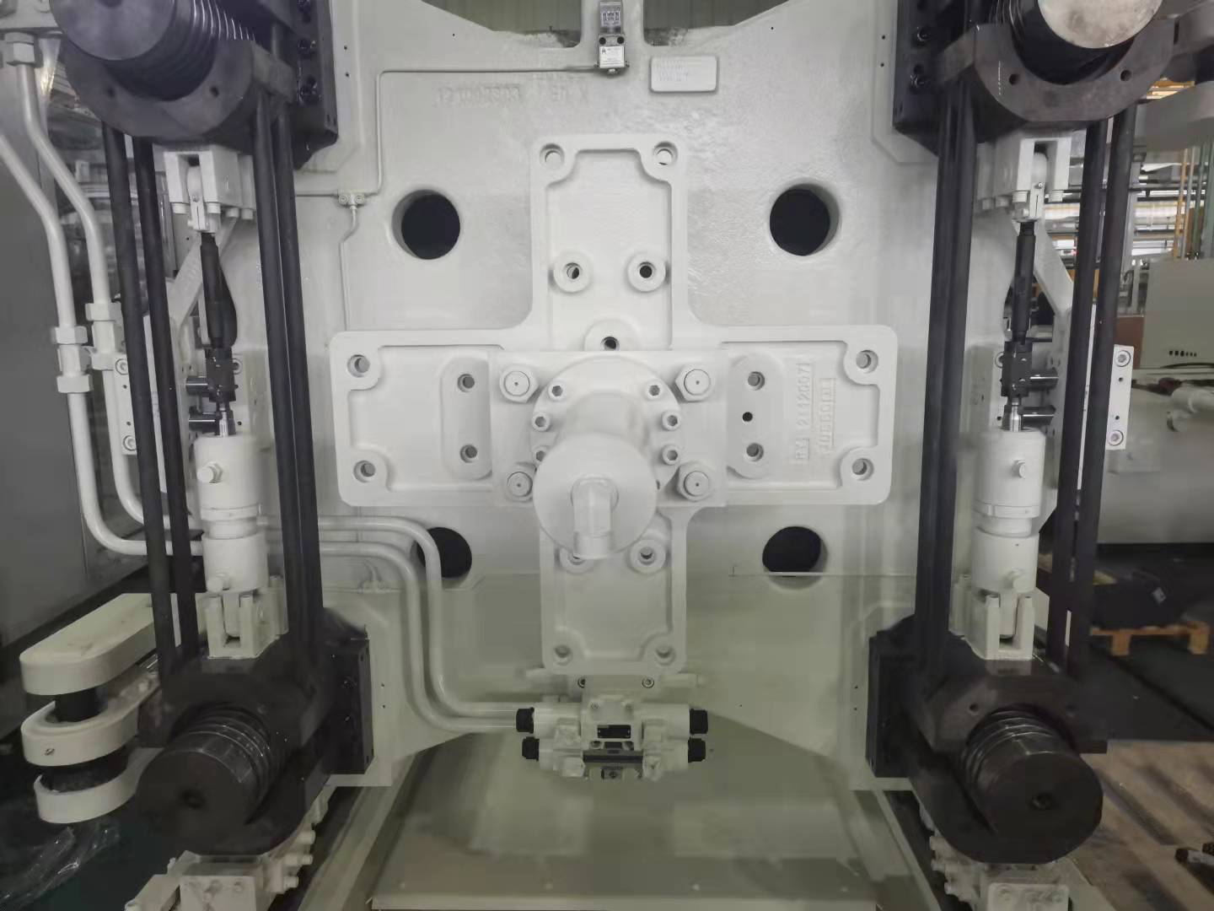
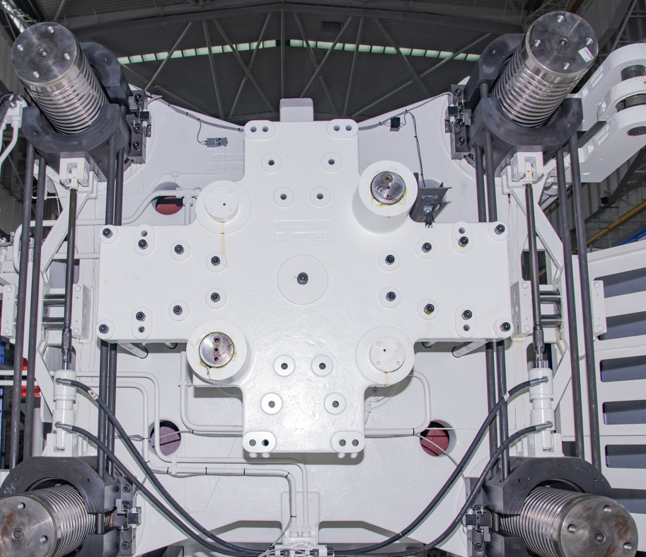
Ejection system
Inverted ejection cylinder
Ejection travel adjustable for more flexibility
450-900T
900T and above

Slide 30
Moving platen support mechanism
The high rigidity of the second plate sliders and the underside and side guide mechanism ensure that the motion accuracy of the moving form is maintained even when heavy molds are installed.

Slide 31
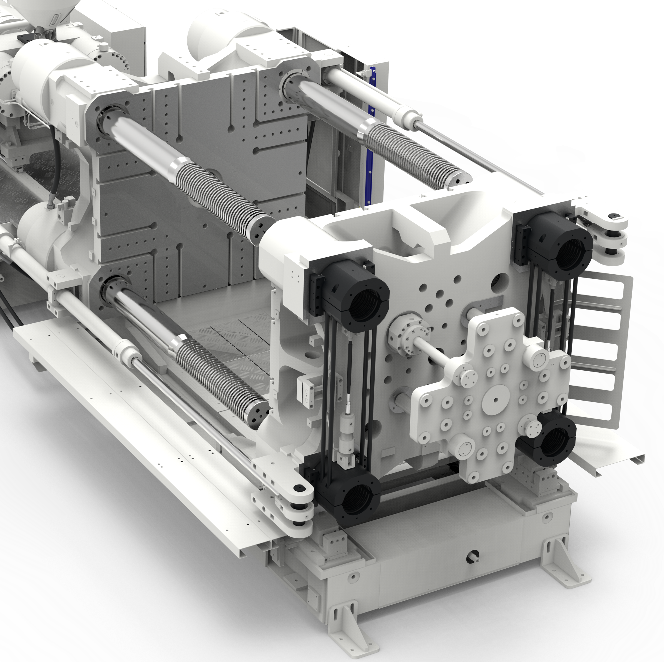
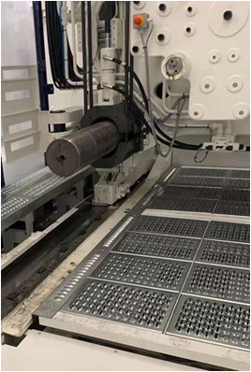
Clamping area safety pedal
Equipped with a large area safety pedal to provide safety protection in the mold closing area.
900T and above
Notes:
New
对应机型

Slide 32
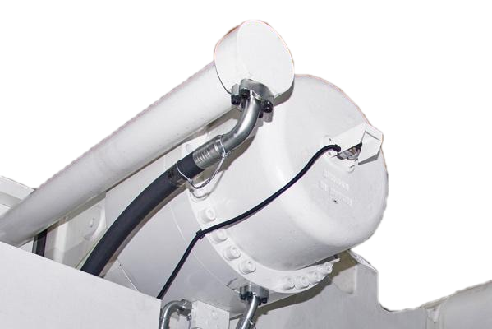
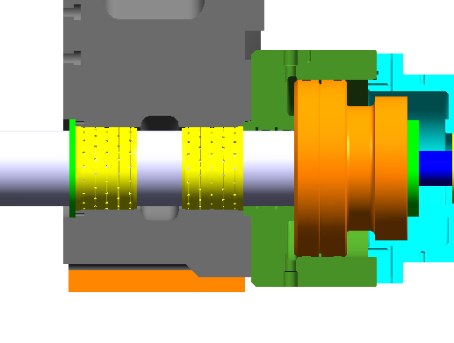
Tie bar positioning
The front and rear bushings provide better support for the tie bar
The clamping cylinder is located in the fixed template
The position of the tie rod is monitored by a high-precision displacement sensor

Slide 33
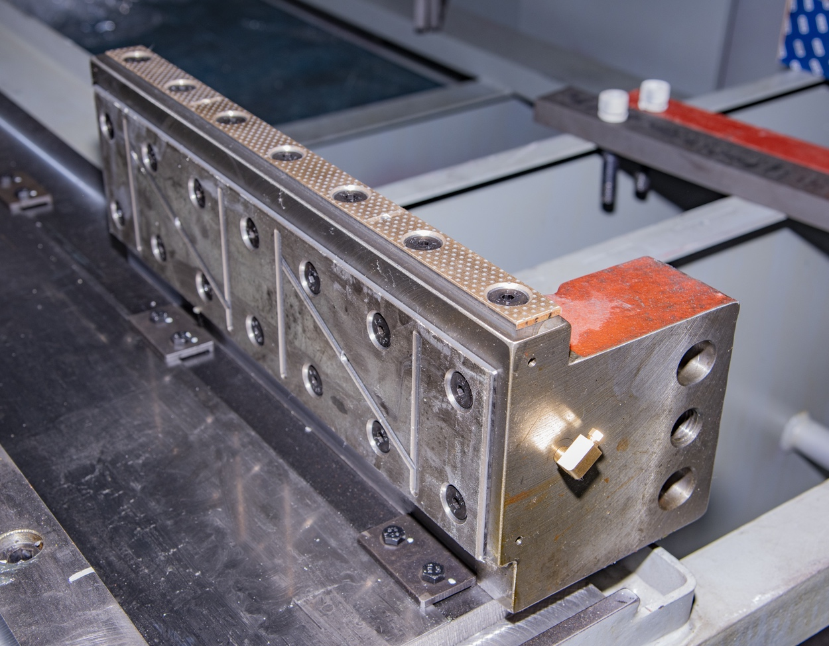
Lubrication system
HT
Clamp
The fixed plate and lock realize oil-free self-lubrication (design pressure injection oil cup), which improves the cleanliness of the machine.
Moving platen material is used at the sliding foot of the second plate, very little oil lubrication (thin oil)
Lubrication parameters are optimized and lubrication frequency is more reasonable

Slide 34
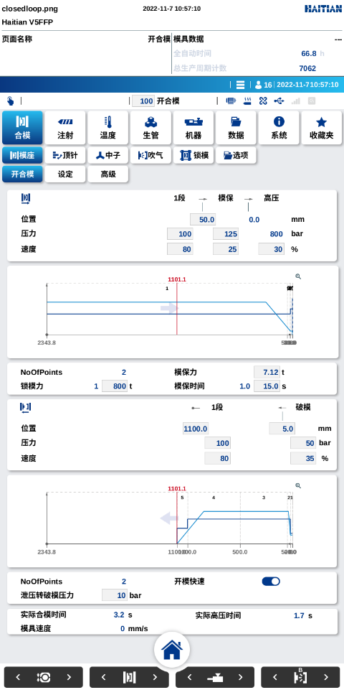
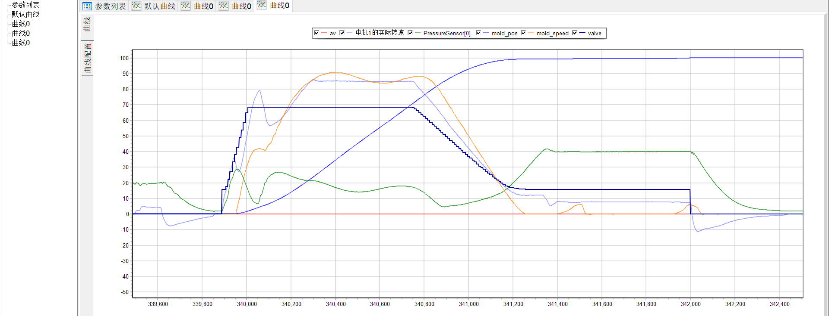
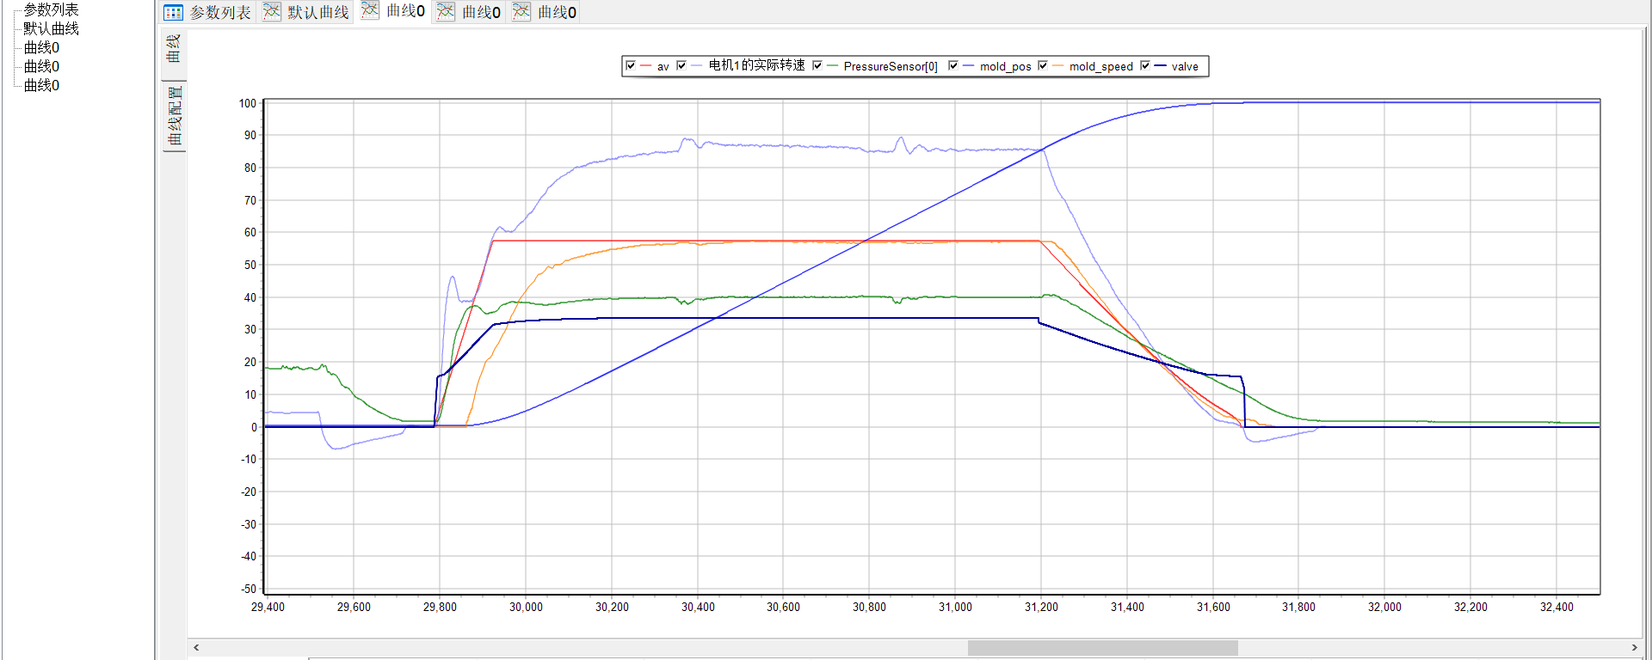
HT Clamp 2.0
The process interface is simplified, the default opening mold 1 section, closing mold 2 sections
Independent process parameters, independent motion control PID, independent proportional valve linear, more stable operation, better curve following
More accurate positioning, open mold positioning repetition accuracy is high, repetition accuracy of 0.5mm
Motion curve: open loop
Motion curve: Closed loop

Slide 35
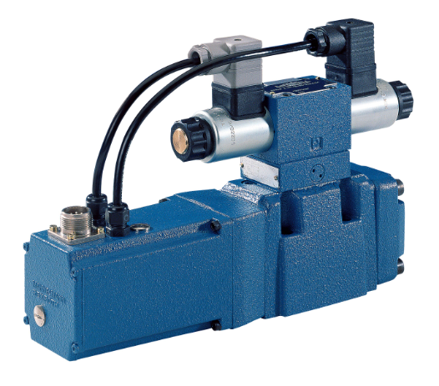
Custom opening and closing mold proportional valve applications
Apply proportional valves with custom spool
The repeat accuracy of the die end position has been increased from the current 1mm to 0.5mm (up to 0.3mm for some models).
Mold locking, mold breaking action is faster
Higher operation accuracy
HT
Clamp
Opening and closing mold proportional valve

Slide 36
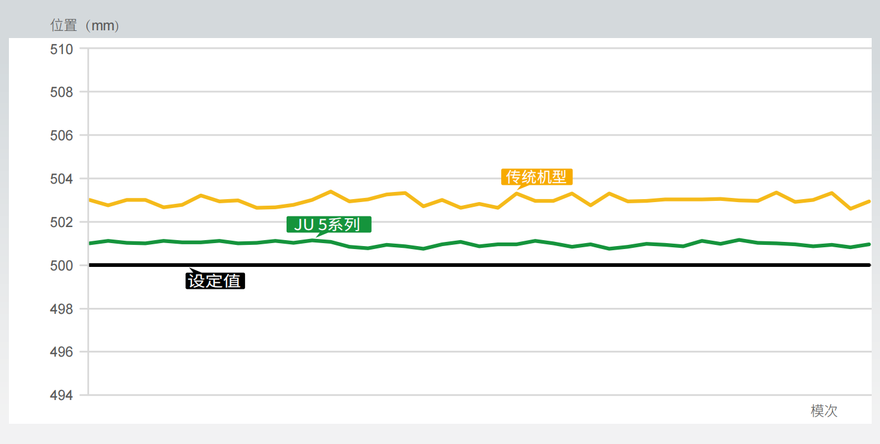
High opening mold positioning accuracy
HT
Clamp
HT Clamp smart mold
opening and closing 2.0
Program self-learning function
Open mold positioning accuracy improved
Position(mm)
Traditional Model
JU V Series
Set Value
Times

Slide 37
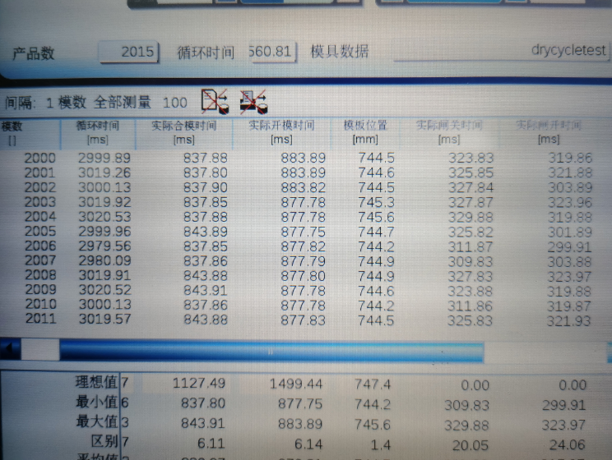
Faster cycle times
Machine of 650T laboratory data: Dry cycle 3s
Control optimization: multi-PID, hierarchical control, program task cycle speed up.
Tuning optimization: parameter setting
Short, reasonable power output overshoot
Short open speed limit
HT
Clamp

Slide 38
High efficiency:
the dry cycle is shortened, and the machine runs faster
Control optimization: multi-PID, hierarchical control, program task cycle speed up
Tuning optimization: parameter setting
Short, reasonable power output overshoot
Short open speed limit
Tons(t) | Cycle (s)
 | JU III | JU V Open loop Closed loop
750 | 4.5 | 4.5 4.5
1400 | 6.5 | 5.87 5.89
1850 | 7 | 6.2 6.5

Slide 39
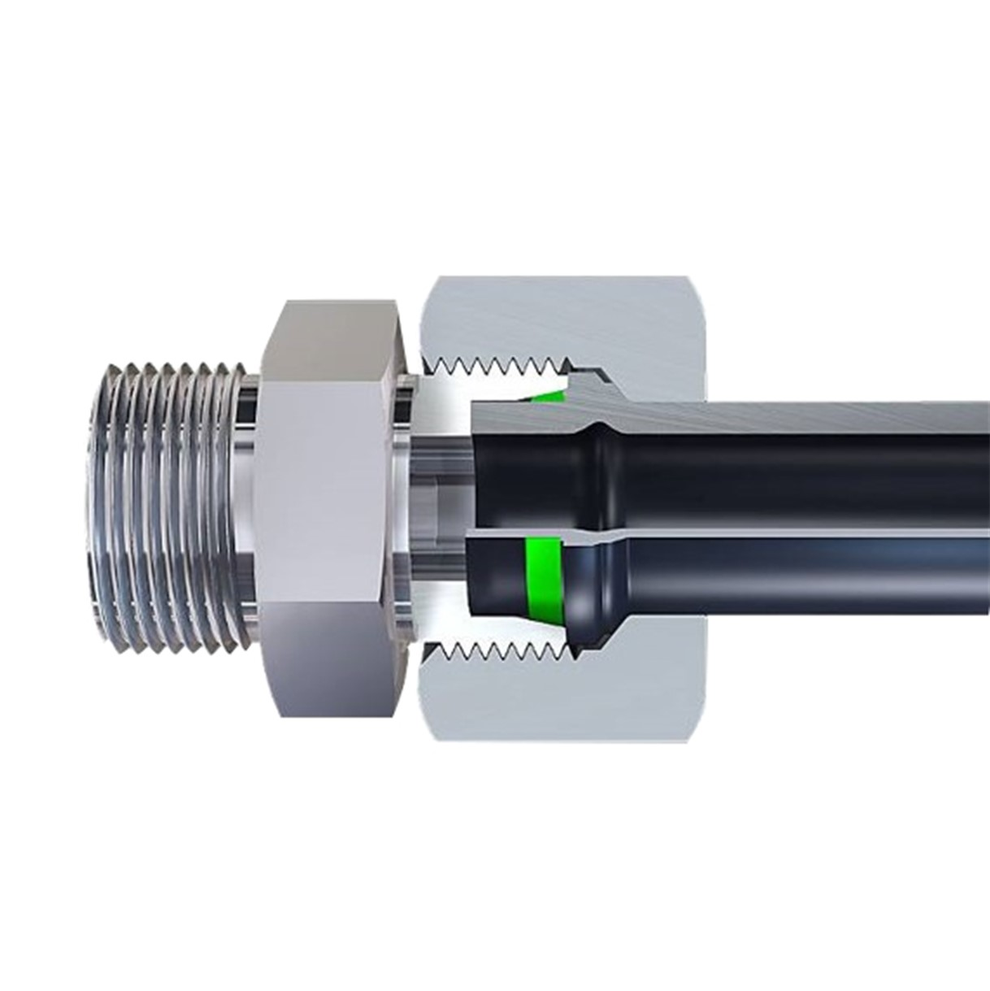
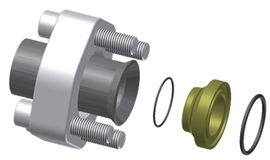
Non-Welding Technology
Power pipeline non-welding process
Cleaner and reduces the risk of oil spills
Notes:
MA IIs Generation: 200ms response time which means we doubled the response time!

Slide 40
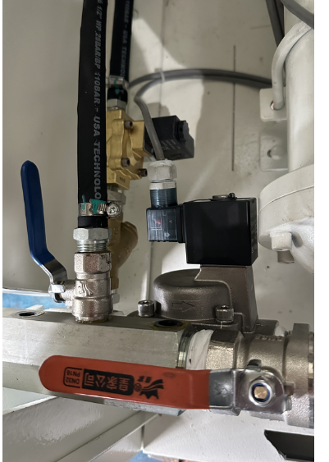
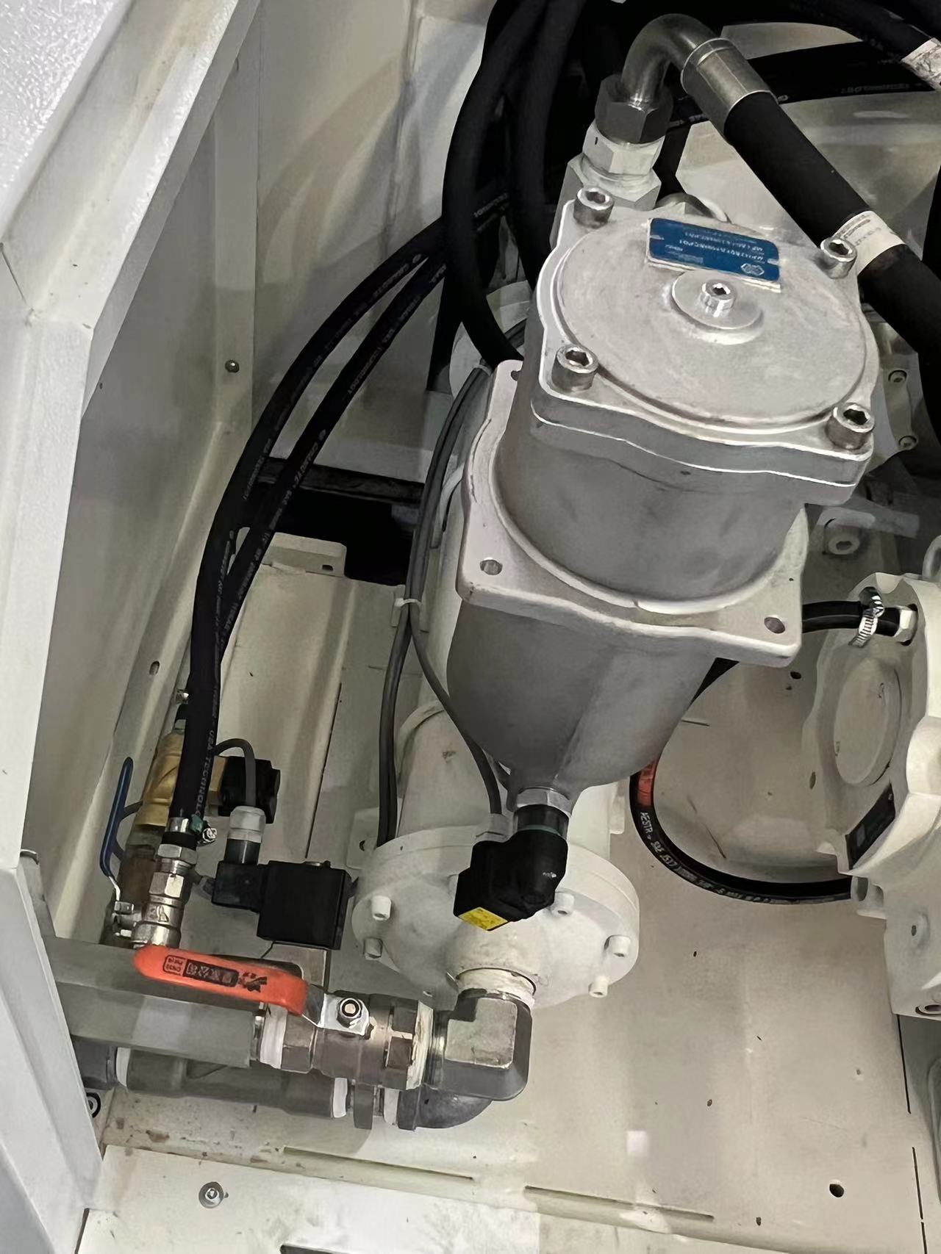
HT Temperature control
Precise monitoring of inlet temperature, oil temperature, effectively improve the cooling capacity and oil temperature control accuracy, so as to ensure the stability of machine performance.
Feeding port, oil cooler water valve standard
Full range of independent cooling and filtration system push-on
At the same time, the independent cooling system adopts the modular design concept, which integrates the oil pump motor, cooler and filter design to reduce the quantity and distribution of pipelines

Slide 41
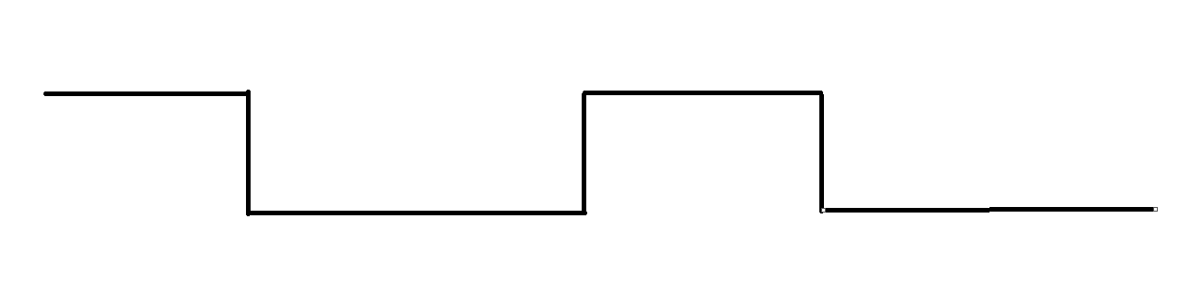
Water Control Valve for Oil Cooling
35℃
45℃
40%
PWM water control valve opens the cooling water circuit when oil temperature > set temperature
Stabilization of Oil temperature
Open/close time ratio
Valve open
Condition | Heating Power | Oil Temp. | Water Flow Rate | Cooling Temp. | Chiller Flow Rate
PWM | 10% | 36.6 | 4.16L/min | 25 | 26L/min
 | 15% | 38.3 | 8.58L/min | 25 | 26L/min
 | 20% | 38.8 | 9.88L/min | 25 | 26L/min
 | 26% | 40.5 | 14.3L/min | 25 | 26L/min
Normally Open | 15% | 32.8 | 26.00L/min | 25 | 26L/min
Test Design:
15% is a normal range, 20% is considered an extreme condition. At 15% heating power, the cooling water PWM can save 17.5 L/min of water supply that occupying 67.3% of the total volume. The water temperature fluctuation is calculated to be between 0.8~1.3 ℃ after PWM control.
Notes:
PWM control logic: By calculating the current temperature, periodically open the cooling water valve:

Slide 42
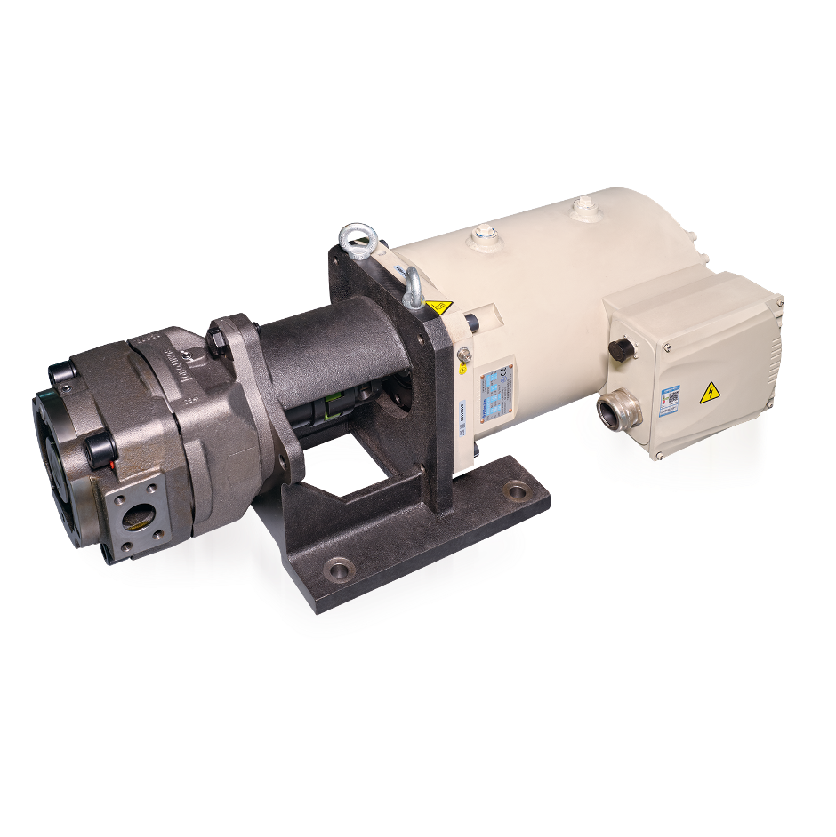
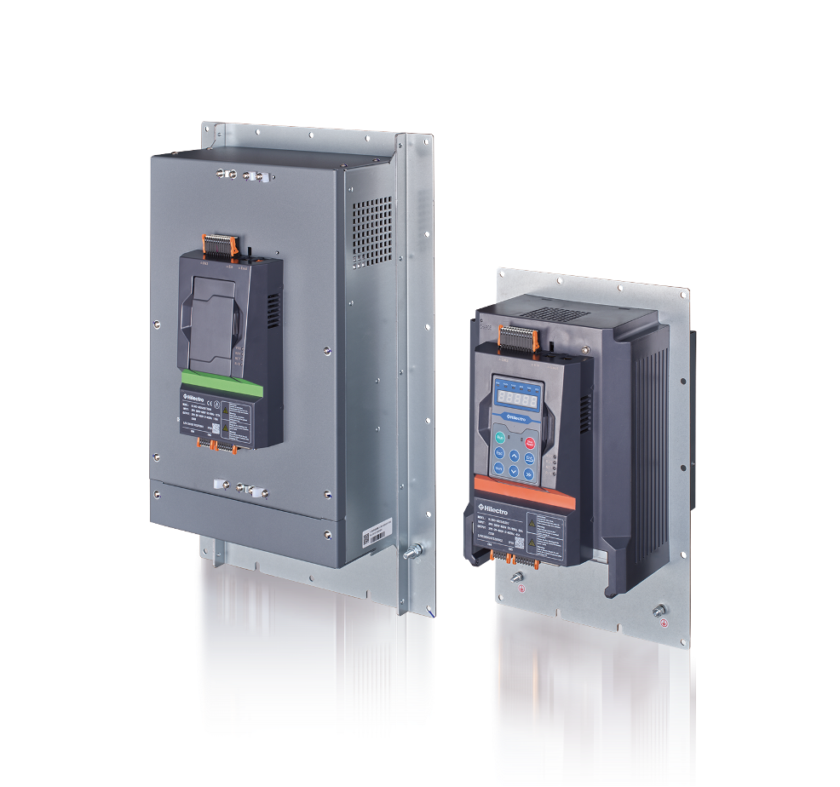
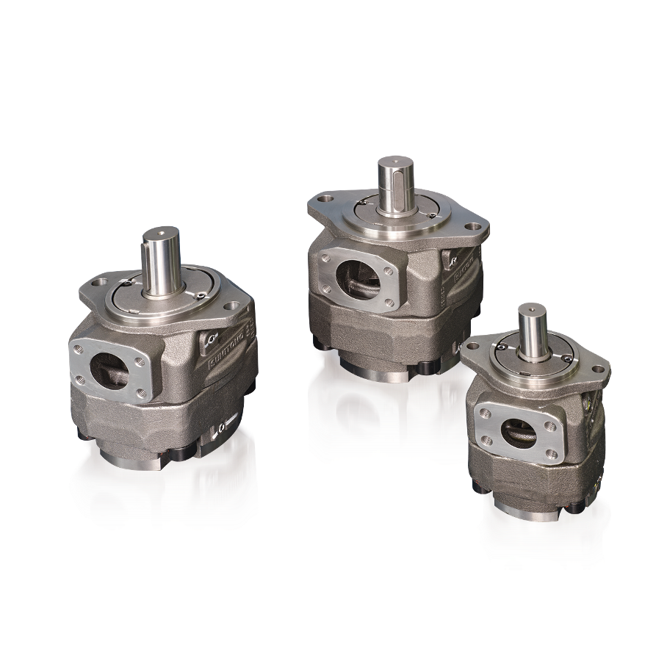

New Servo Drive System
1
2
3
The fifth generation special servo motor
Fifth generation dedicated servo drive
Japan SUMITOMO latest high speed gear pump
The fifth generation of dedicated servo system independent researched by Haitian
New high drive servo system
Japan SUMITOMO latest high speed gear pump
High efficiency, energy saving, low noise, stable operation, excellent performance
Faster injection with accelerated response of 100ms

Slide 43
Mars Servo Drive System
Dedicated servo power system for injection molding machines
High performance servo drive system
SUMITOMO
high speed gear pumps
185 bar
Efficient, energy saving, quiet and stable operation
Ultra-high dynamic response of 100 ms
System pressure
Notes:
MA IIs Generation: 200ms response time which means we doubled the response time!

Slide 44
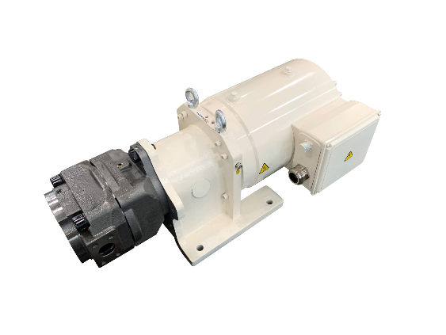

Haitian Servo Technology
Total energy
20-40%↓
Total performance
20%↑
Total performance
Generation V
5%↑
Total energy
Generation III
50%↓
2023
Generation II
2018
Generation I
2012
2006
Notes:
五代机持续精进产品力，能耗降低20%-40%，是近年来能耗技术的进一步突破，也是伺服节能技术迭代的最新成果。轻量化、紧凑型设计进一步实现资源节约，更将为我们的客户带来更多的应用优势和成本下降。
The fifth generation machine continues to improve its product strength, reducing energy consumption by 20% -40%, which is a further breakthrough in energy consumption technology in recent years and the latest achievement in servo energy-saving technology iteration. Lightweight and compact design further realizes resource conservation, which will bring more application advantages and cost reduction to our customers.

Slide 45
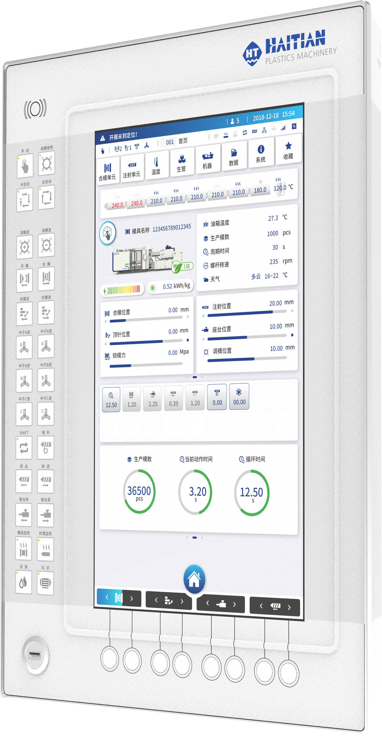
Software & Control
Clamping Unit
Control Panel
New UI Design
HT CHARGE
HT ENERGY
HT Temperature Control
HT·DIAGNOSE
HT•XTEND

Slide 46

Control panel upgrade
New Control Panel
KEBA controller + 19.68 inches Panel
New UI design
Configuration of large screen control panel, bring intelligent friendly, convenient "man-machine integration" interactive experience

Slide 47
New UI design
Centralized display of machine status
Animation effect
Card style design
Display of important production information
New menu system

Slide 48


HT Charge
Before optimization
Intelligent Charging
Velocity decrease
Energy consumption reduction
Screw barrel wear is reduced
After optimization

Slide 49


HT Energy
No need to match a electric meter, and easily enable refined energy consumption monitoring and analysis
Enables customers to optimize energy efficiency
Easy for customers to plan the power layout of the plant
Easy for customers to find the most energy-efficient production plan
Refined energy consumption display

Slide 50


HT Diagnosis
Normal
Position Indicates the status when the line is broken
The self-diagnosis function uses ETHERCAT technology, which can quickly locate the fault point, timely feedback on equipment anomalies, reduce downtime, and escort daily production.
Configuration :
Host +J6 card +6 drives +6 digital ruler

Slide 51





HT Diagnosis
The online help function provides troubleshooting measures
Maintenance tips
QR code alarm help
诊断及指南

Slide 52

Flexible Integration
Through the powerful information technology capability and the connection of global factories, the operation status of each injection molding machine in all factories in the world can be mastered in the central war situation control room.

Slide 53


Efficient and flexible integration and control of peripheral auxiliaries
To realize the injection molding machine control system as the center, centralized control of each production unit, so that the injection molding machine really become the center of the entire molding system and the base station of the network system.
Mold information is associated with peripheral equipment to achieve highly automated production
Make production data more
transparent and production
management more efficient
Smart auxiliary shortcut button机

Slide 54








OPC UA, EUROMAP
Equipped with OPC UA, EUROMAP and other international common interfaces to achieve a wider range of application scenarios

Slide 55

Flexible Integration
Dry hopper Integrated Control (option)
After determining the type of raw materials, the corresponding drying temperature and drying time are intelligently recommended.
After setting drying time, countdown reminder
Timing switch function
Fan, electric heating working state display

Slide 56




Industry Application
Automotive
Consumer Electronics
Appliances
Daily Necessities
Plastic parts products in the automotive manufacturing industry are suitable for various process technologies and application needs, providing efficient and high-quality solutions.
In the consumer electronics industry, plastic spare parts products in consumer electronics are designed to provide efficient and high-quality solutions for molding multiple cavities.
Plastic products in household appliances
provide flexible, efficient and stable solutions based on product characteristics
Plastic products used in daily life respond to the surge in customer costs, focus on customers' return on investment, and provide various economical solutions
Notes:
MA IIs Generation: 200ms response time which means we doubled the response time!

Slide 57
JUPITER SERIES
Thank You!
JU

