Slide 1
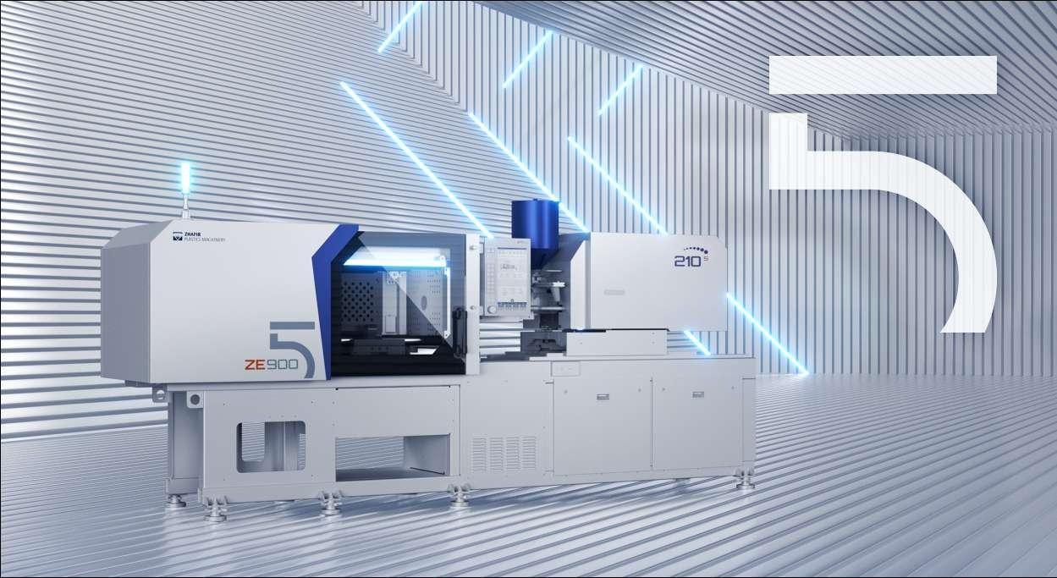
VE ZE

Slide 2
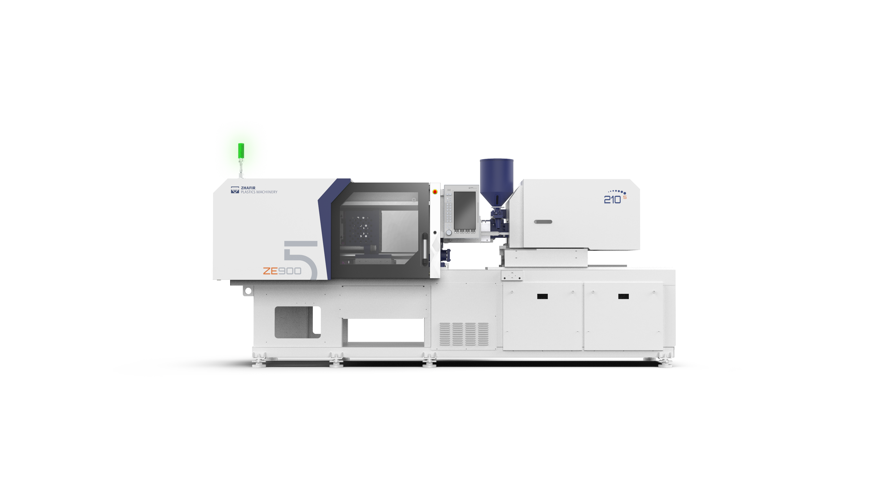
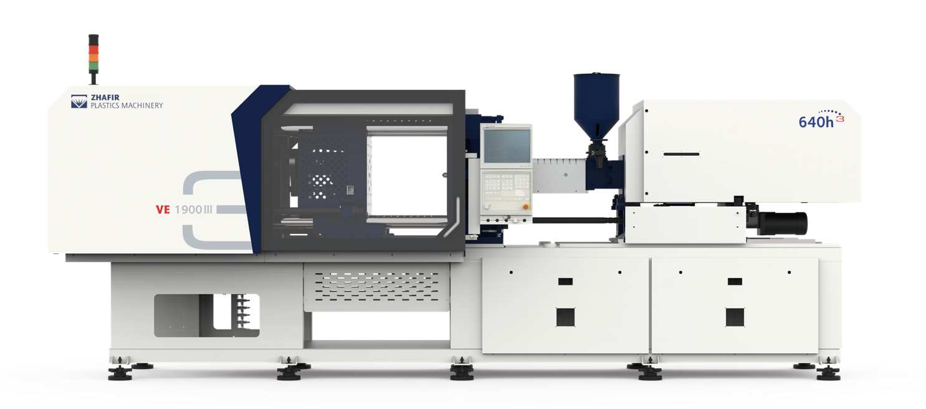
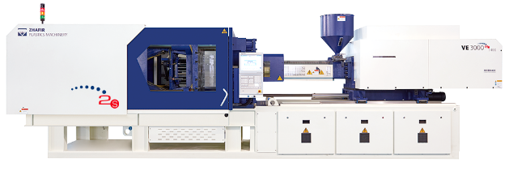
ZHAFIR Fifth Generation Electric Technology
The future of smart electricity, the ultimate exploration
After nearly 20 years of technical exploration and industry deep cultivation, Zhafir electric technology has now been fully upgraded to the fifth generation. The comprehensive upgrade of structure and control technology and the blessing of many intelligent functions are bound to bring a more extreme production and use experience.
Fifth Generation
Revolutionary improvements in control architecture and computing power
Compact design of the machine
Man-Machine interaction experience change
Realize multi-dimensional display of intelligent functions
2007
2012
2019
First Generation
The VE series electric machine debuted at K-SHOW
Entrying into the all-electric field
Second Generation
Iterative upgrading of mechanical structure
Reliability design continues to improve
Three machine platform technology established
Third Generation
Servo drive system comprehensive upgraded
The industry special aircraft for market segments form a coverage system, and the solutions are constantly complete.

Slide 3
ZHAFIR Fifth Generation Highlights
1
2
3
Compact overall design
High efficiency clamping device
High precision injection device
Through design optimization, the overall size of the machine is greatly reduced compared with the original machine, and the plant utilization rate and the output per unit area are further improved.
The manufacturing process is improved, the appearance quality of the machine and the dimensional accuracy of the parts are significantly improved.
Faster mold opening and closing speed, with low inertia, high response ejector mechanism. The operation efficiency of the machine is significantly improved .
The high rigidity formwork and high rigidity fuselage provide better guidance support and clamping for the mold to meet various stringent process requirements.
The whole series adopts symmetrical integral displacement layout, and the fixed formwork is more balanced.
Box type low friction sub-shooting platform structure, equipped with high precision pressure sensing module, provides a strong guarantee for ultra-high precision injection molding.
4
5
6
New control system
Excellent drive control performance
Excellent intelligence and internet capabilities
Using multi-CPU control architecture, the computing and sampling speed is significantly improved.
The new man-machine interface brings users a comfortable experience.
More accurate clamping force, with a smoother opening and closing action.
The optimized temperature control mode and injection control mode greatly improve the measurement accuracy and injection stability.
Multi-dimensional display of intelligent functions
Equipped with advanced Internet interface and peripheral equipment interaction tools

Slide 4
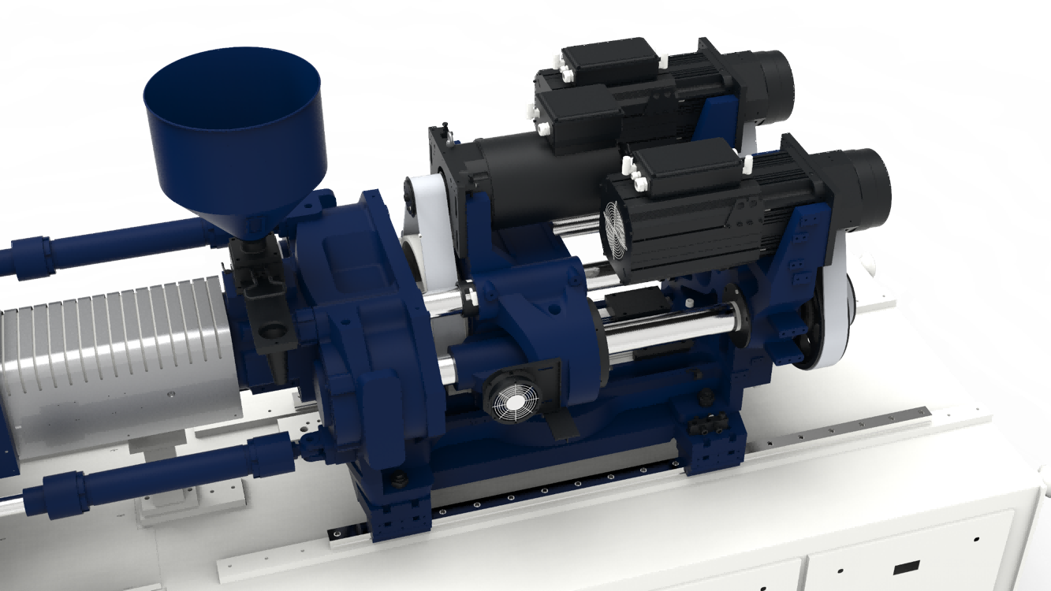
Injection Unit
- Main Characteristics
Various combinations
Injection structure diversification
Optimization of plasticized parts
The temperature control accuracy of the feed outlet is improved
Box injection mechanism
Precision wire rail support
High precision pressure sensing module
Diversified injection characteristics
Injection stability
Injection molding and pressure holding optimization
The whole series adopts symmetrical double integral transfer structure
Rotary injection unit

Slide 5
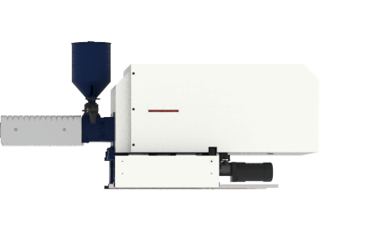
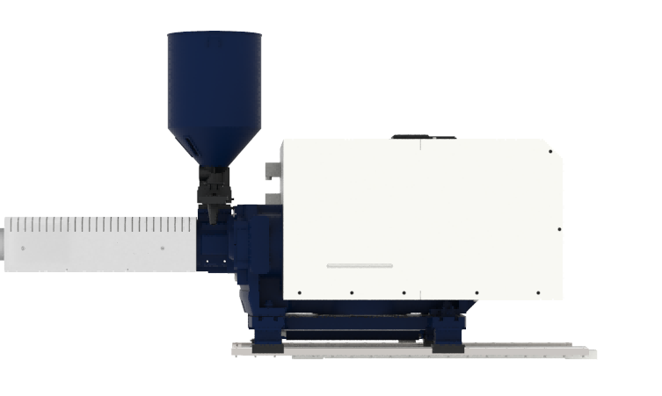



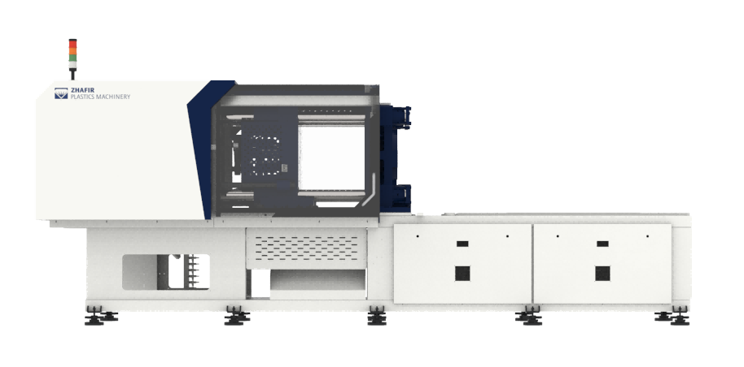


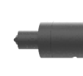
Injection Unit
- Various Combinations
Diversified combination of clamping device and injection device is realized

Slide 6
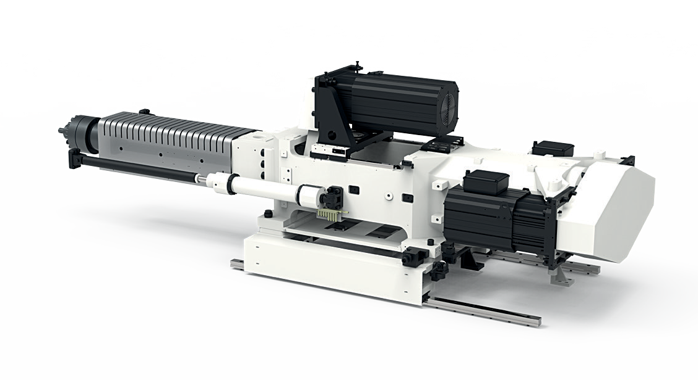
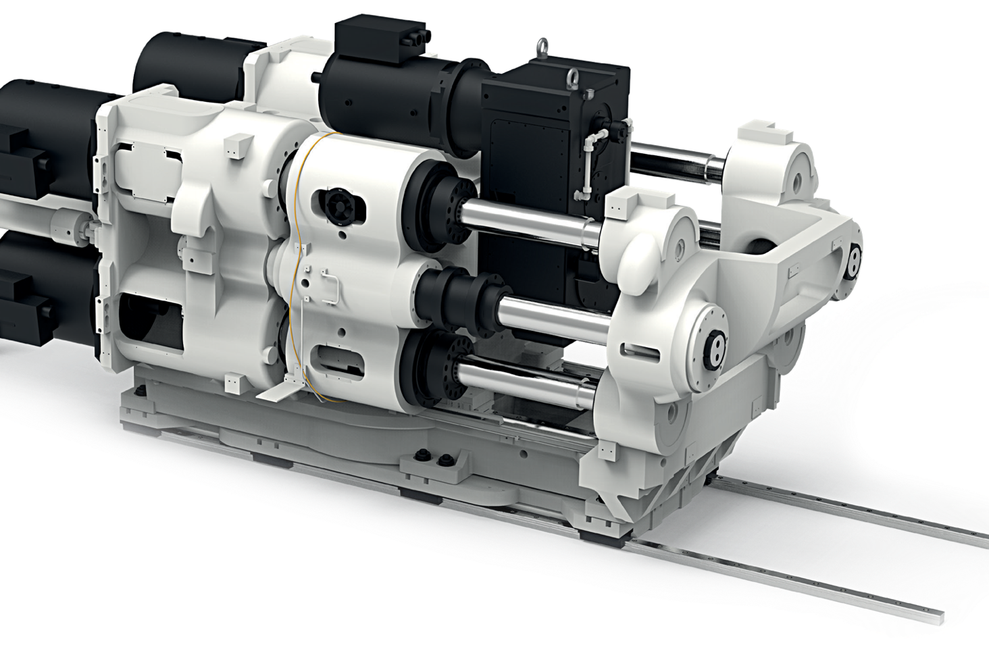
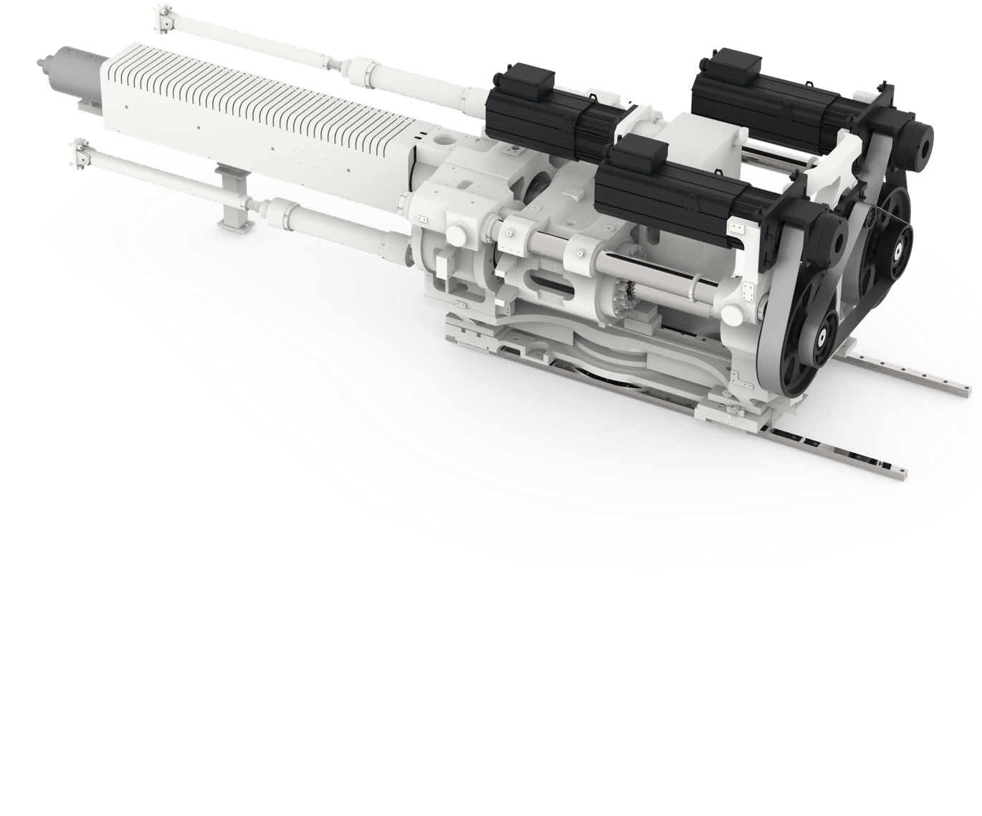
Injection Unit
-Injection Structure Diversification
Single axle drive
Double-axis drive
Four-axis drive
Box structure design
One line servo injection system layout
High precision and high efficiency
Injection unit：50 ..... 1700
Dual servo synchronous injection system layout
Comes with balanced injection and correction protection function
Injection unit： 2250 ... 12800
Four ball screws, four motors direct drive layout design
Multi-servo shaft synchronous drive
High torque servo motor direct drive multi-axis control technology
Injection unit ： 17800-22800
Page 6

Slide 7
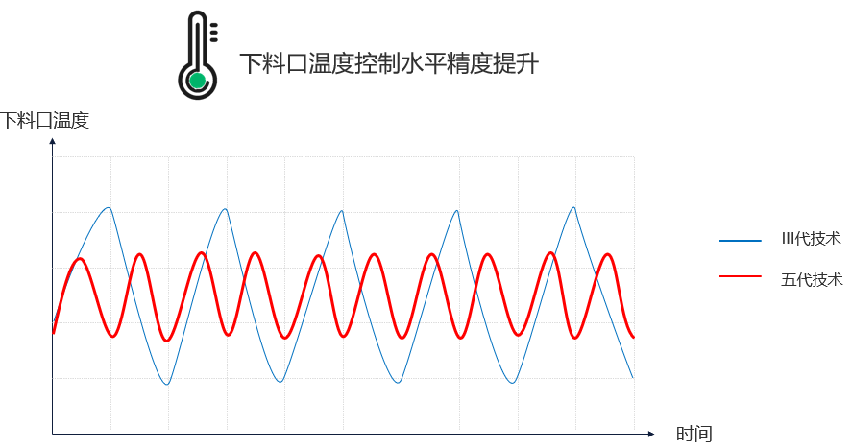
Injection Unit
- The horizontal precision of temperature control at the feeding opening is improved
Through the optimization of the control model, the feed valve is accurately controlled, and the temperature fluctuation range of the feed outlet during the molding process is narrowed by more than 70%, and the temperature fluctuation range of most models is narrowed to within ±0.5℃, which greatly improves the stability of specific material storage.
The horizontal precision of temperature control at the feeding outlet is improved
Temperature of feeding outlet
Technology III
Technology V
Time

Slide 8
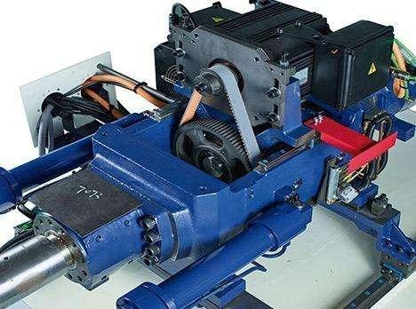
Injection Unit
- Box injection mechanism
Box structure design, the whole one-time processing is completed, to avoid cumulative errors
One line servo injection system layout
High precision and high efficiency
Box injection mechanism(50-1700)
Notes:
Compact and efficient structure
Already known from past series

Slide 9
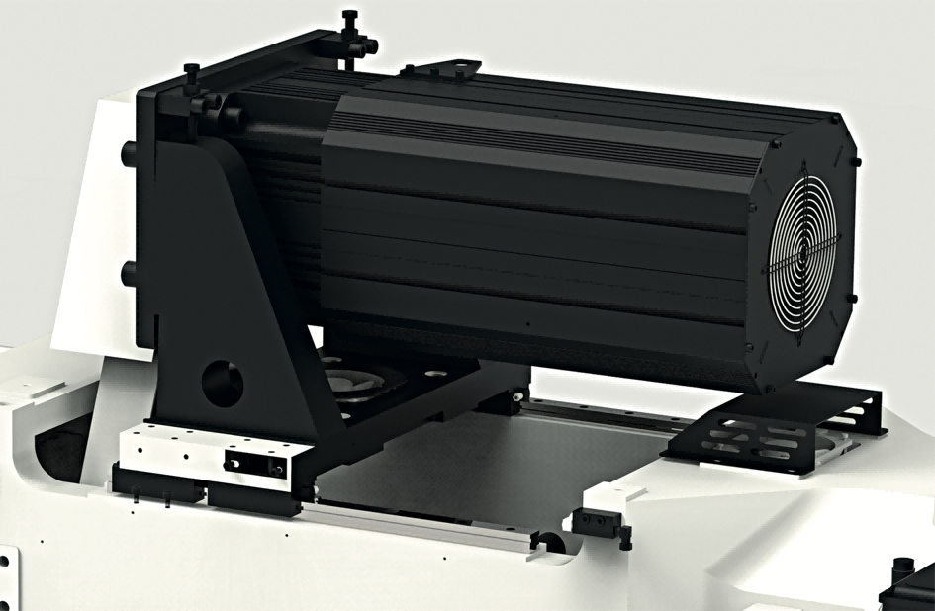
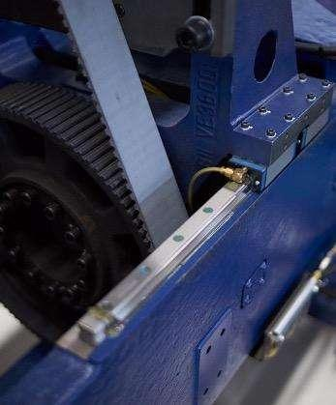
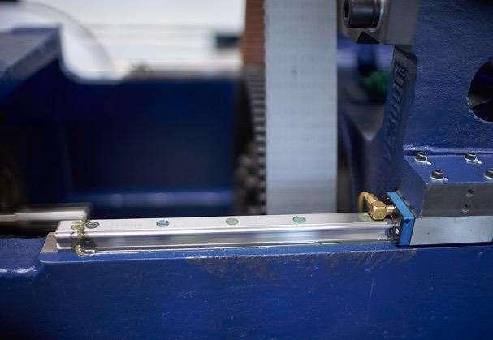
Injection Unit
-Precision wire rail support
High precision rail provides low friction injection guide, which establishes a good foundation for high precision back pressure control and injection control
More stable
Environmental cleanliness

Slide 10
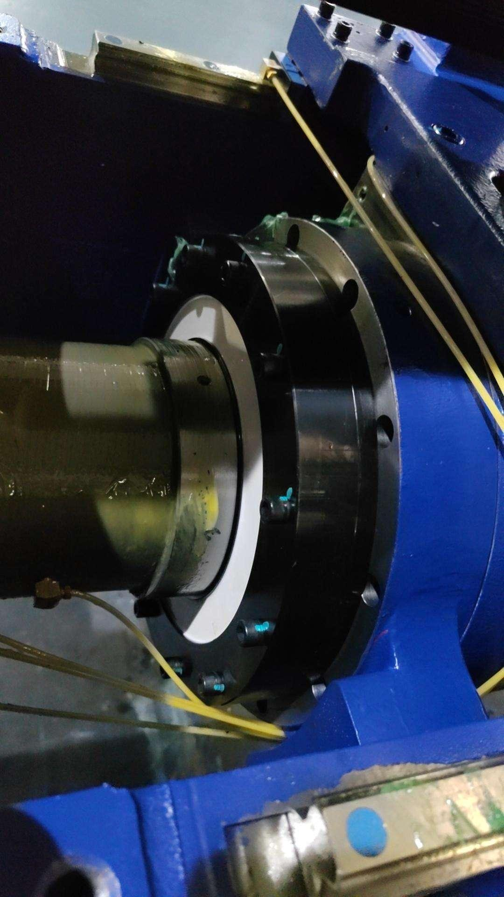
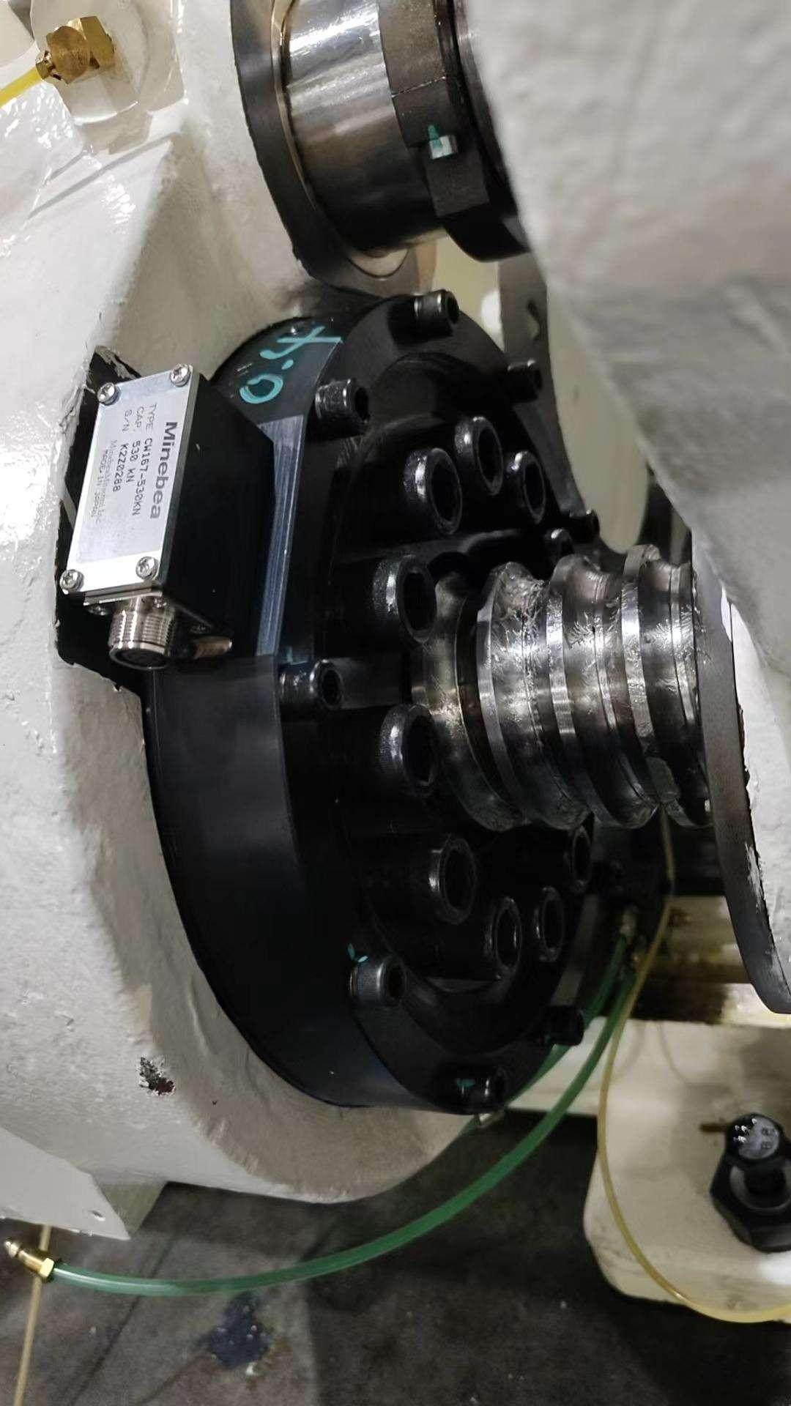
Injection Unit
- High precision pressure sensing module
With the support of ZHAFIR latest EMC technology and anti-drift technology, the top pressure sensing module constitutes the core guarantee necessary for ultra-high precision molding.

Slide 11
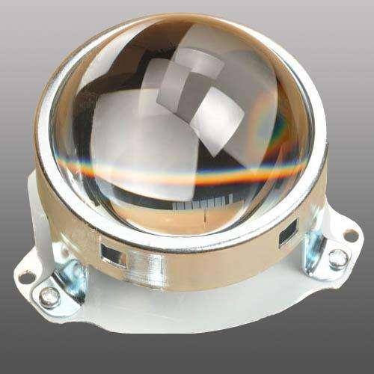

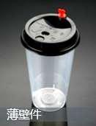


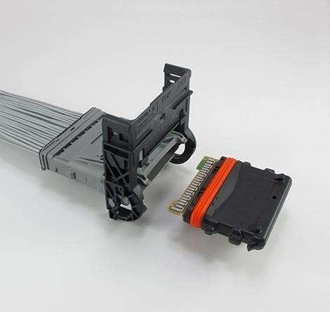
Injection Unit
-Injection diversity
Pressure Holding For Long Time | Standard | High Speed High Pressure Type
For example：VE900V-210 Suitable for most applications It is especially suitable for thick wall parts that need to hold pressure for a long time, such as thick wall optical lenses, thick wall gears, etc | For example: VE900V-210h Suitable for thin-wall, precision technical parts, such as mobile phones, tablet computer housing, buttons, etc | For example: VE900V-210hs Suitable for ultra-thin or thin-wall multi-cavity applications, such as LED brackets, precision connectors, light guides, etc
Optical component
Thick-walled part
Thin-walled parts
Precision parts
Cleaning room products
Precision connector
Page 11

Slide 12
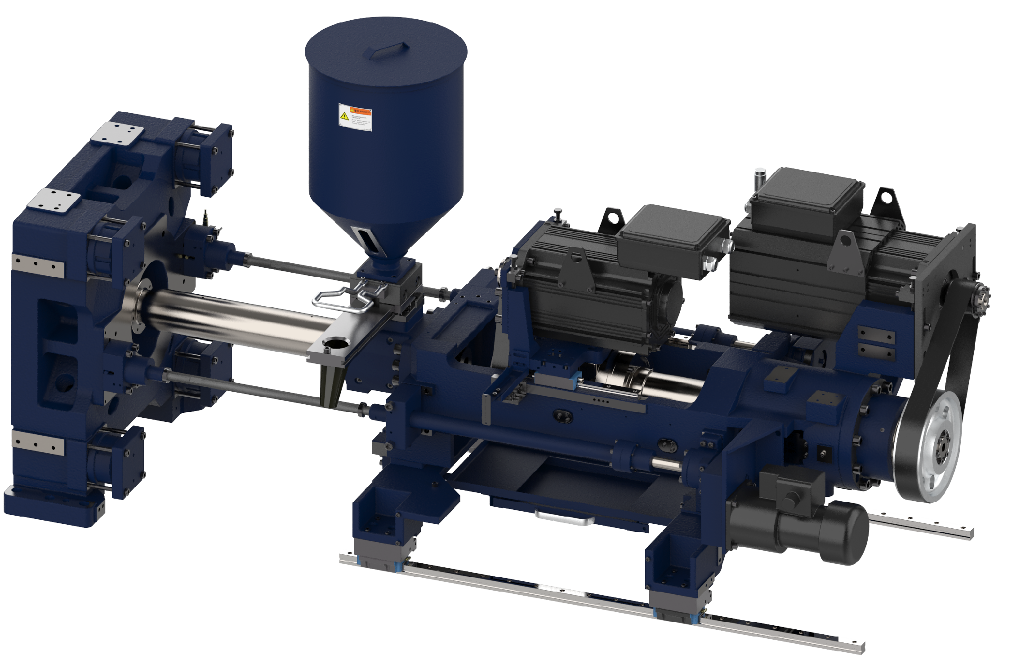
Injection Unit
- The whole series adopts symmetrical double integral transfer structure
The symmetrical layout of the double tie bar integrated displacement structure makes the force of the fixed platen completely balanced, effectively avoiding the tilt of the fixed platen caused by the force imbalance, so as to ensure that the mold runs in the normal open and closed state, and ensure the stability of the nozzle contact force during the forming process.

Slide 13
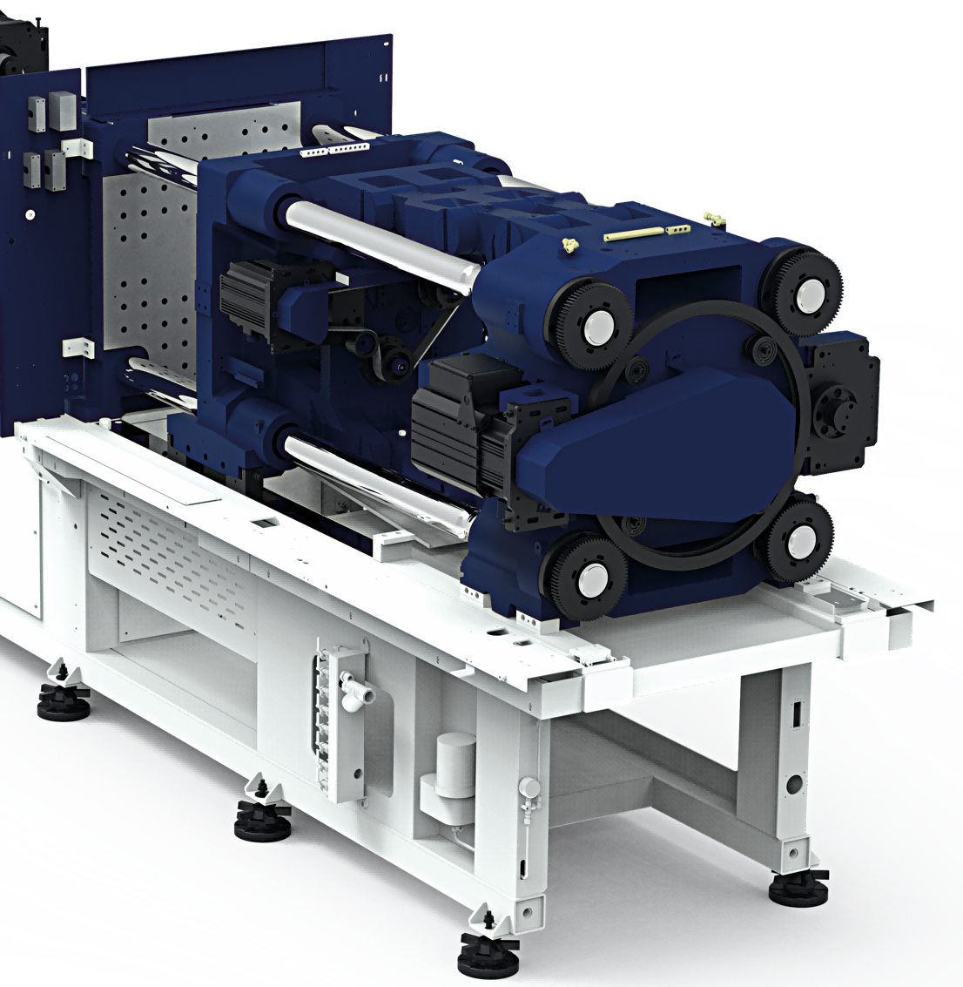
Clamping Unit
Detachable structure
Moving platen optimization
Moving platen support structure
Compact curved elbow structure
HT mold opening and closing 2.0
Dry cycle lifting
HT mold protection
Smart ejection
Ejection speed increased
Closed-loop control of clamping force（Option）
Automatic mold thickness measurement and precise mode-locking force control

Slide 14
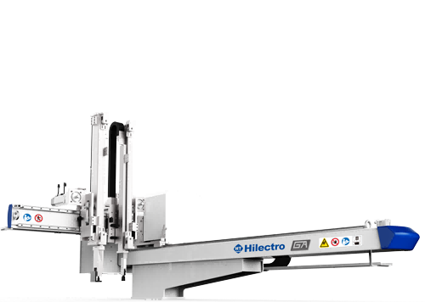
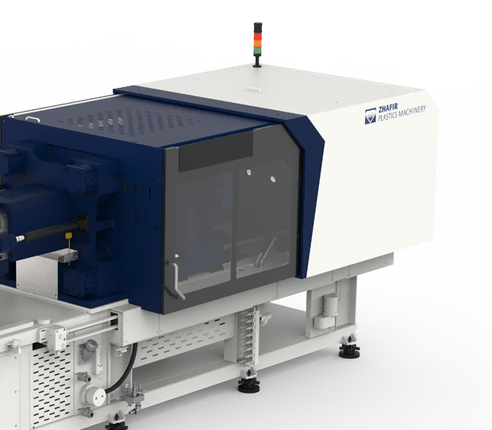
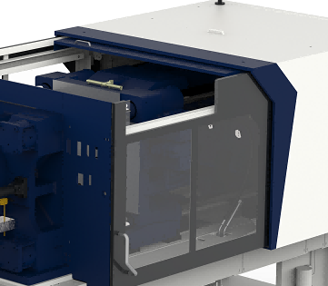
Clamping Unit
-Detachable structure
Manipulator channel reserved above non-operating side (detachable structure)
Page 14

Slide 15
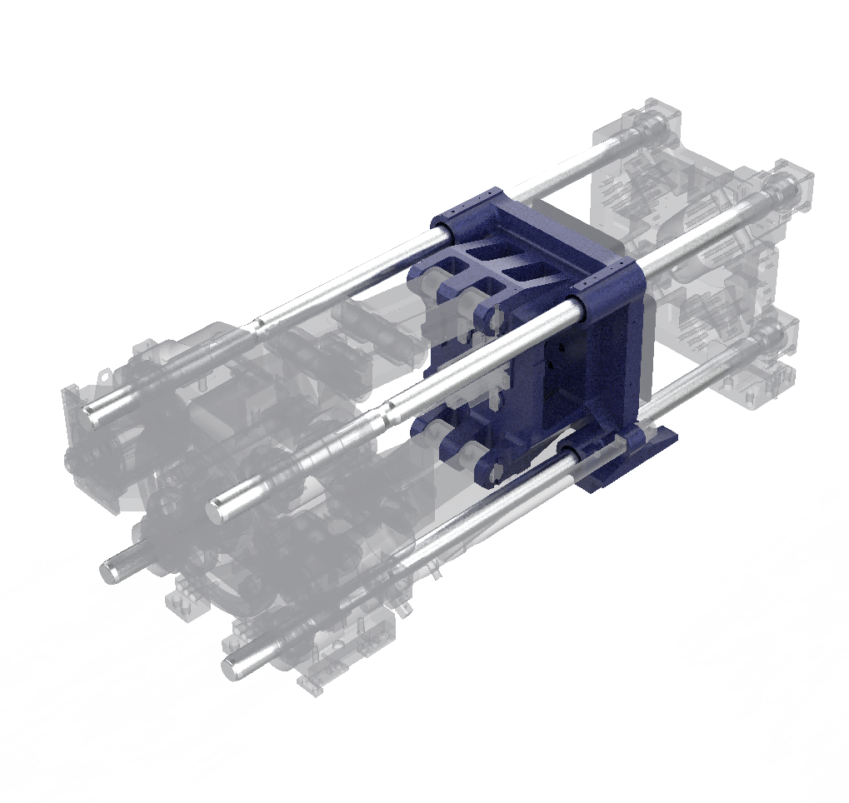
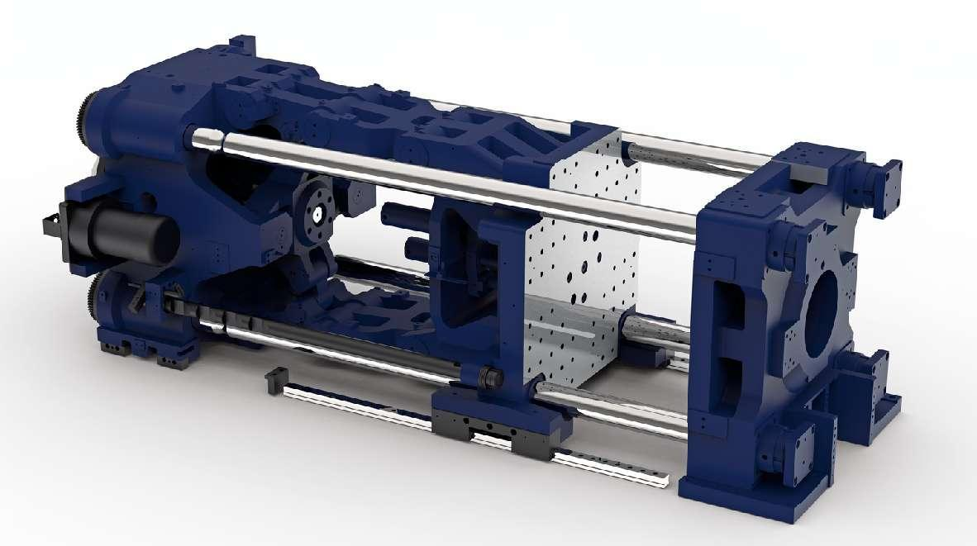
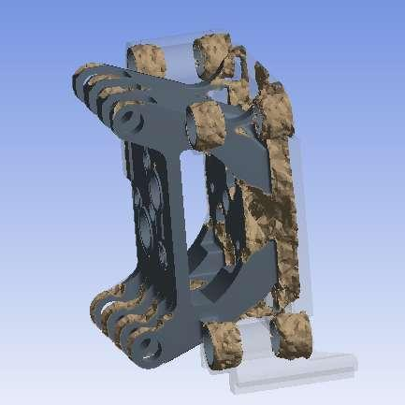
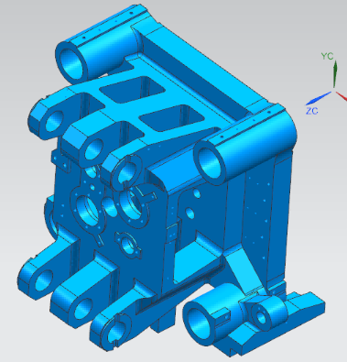
Clamping Unit
-Moving platen optimization
Provide the choice of template support mode - line rail type/slide foot type (Below 650T models）；
Combined with topological cloud image optimization, the platen parallelism maintenance performance is greatly improved.
Through the application of high rigidity composite platen, the small deformation on the moving platen is controlled, so that the clamping force can be more evenly distributed on the mold, and the stable molding of precision injection products can be realized.
Linear guide
Topology optimization
Composite platen application （option）

Slide 16
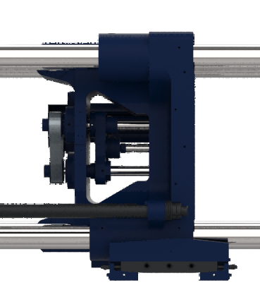
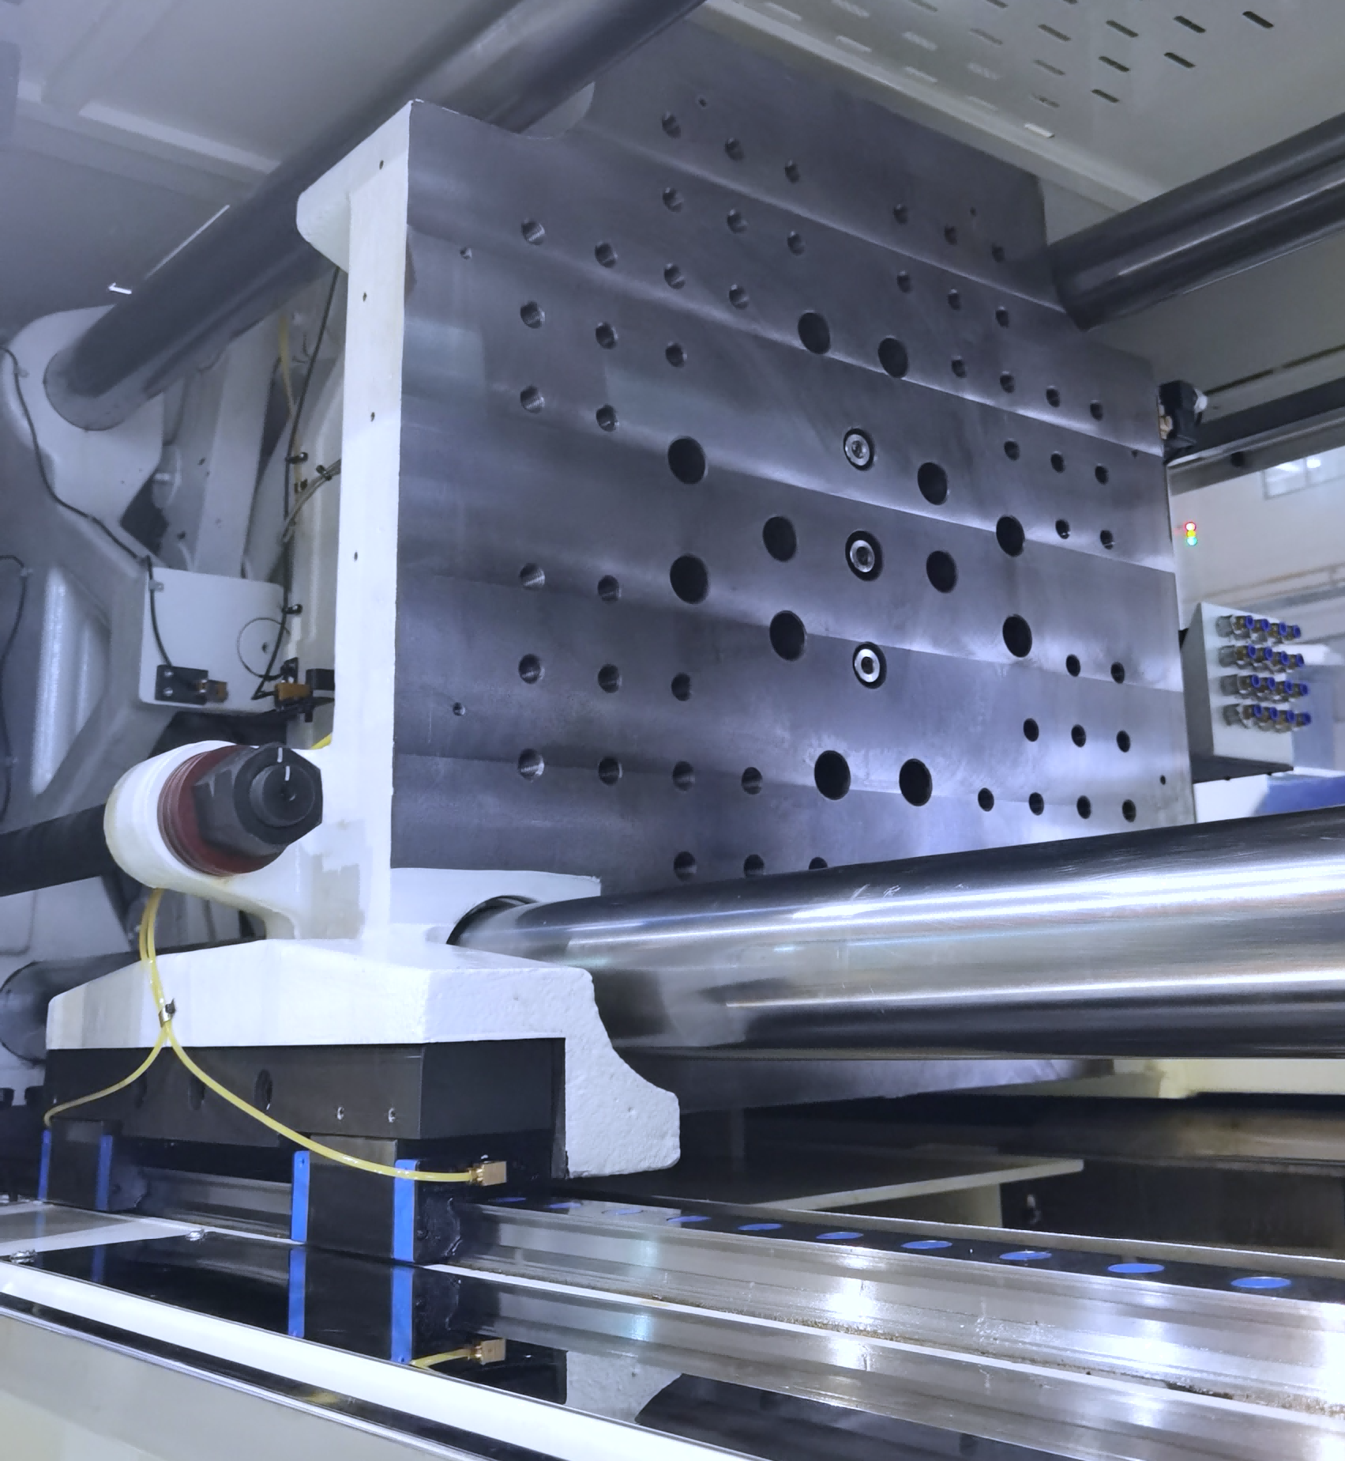
Clamping Unit
-Moving platen support structure
Mold opening and closing line rail support （Option）
The tie bar and form are of non-contact construction
Ensure a clean mold environment and greatly improve the parallelism of the platen
Effectively prevent mould tilt, mould durability and precision characteristics are protected
Standard support structure
Balance and support the integrated structure
The parallelism of the template is increased
Mould bearing capacity increased
Page 16

Slide 17
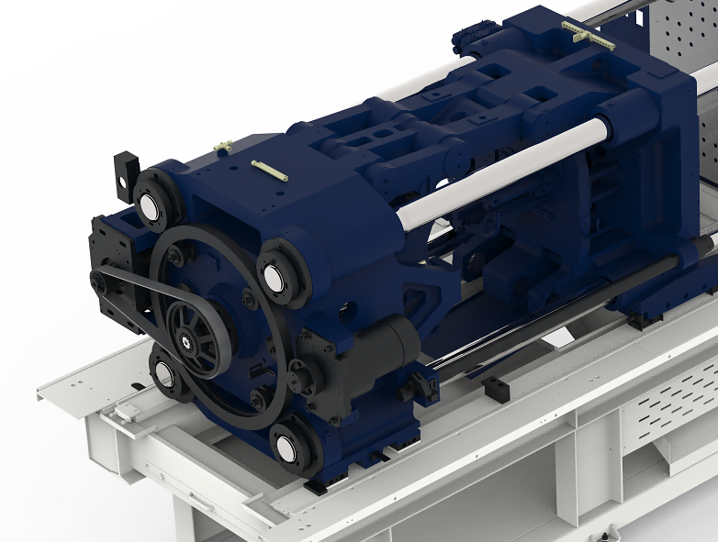
Clamping Unit
-Compact curved elbow structure
New and optimized elbow bending system
Improve system rigidity and template parallelism
The speed of mold opening and closing is increased
Notes:
Redesigned connection system
+ Software -> Improvements

Slide 18
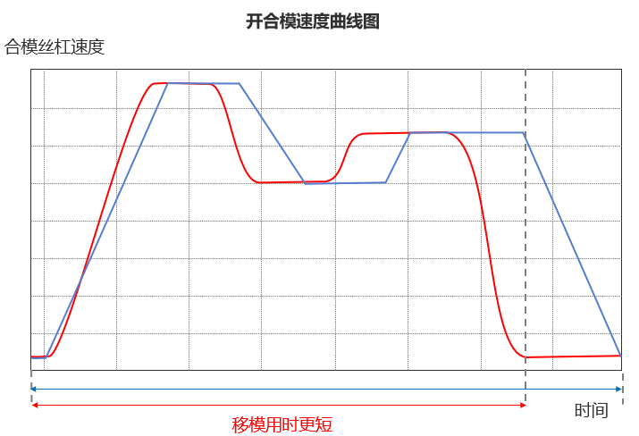
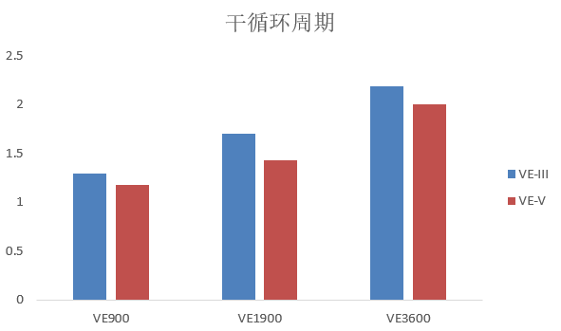
Clamping Unit
-HT mold opening and closing 2.0
The maximum mold opening and closing speed is increased by about 20% on the basis of the three generation machine
Mold opening and closing anti-vibration acceleration and deceleration control S-Curve function upgrade, generate smooth speed mode during acceleration and deceleration, can suppress vibration at the same time, more high-speed mold opening and closing, to achieve faster dry cycle.
Speed diagram of mold opening and closing
Drying Cycle Time
Speed of ball screw
Time
Mold moving time shorten

Slide 19

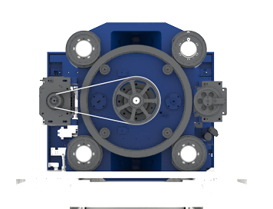
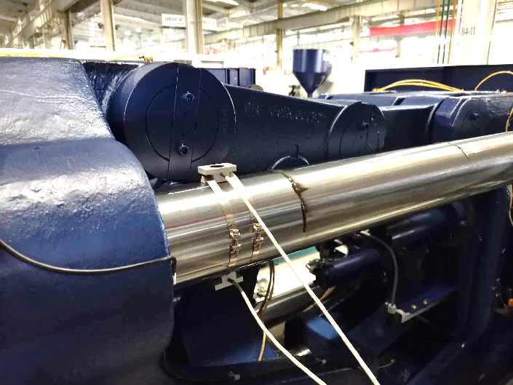
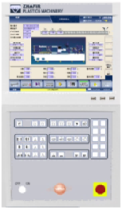

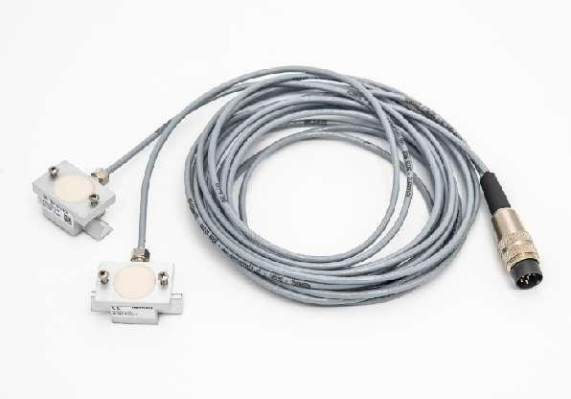
Clamping Unit
- Automatic mold adjustment and clamping force accuracy
Through the continuous optimization of automatic mode modulation algorithm, the linearity and repetition accuracy of mode-locking force are greatly improved.
The closed-loop control of clamping force is optional, which is suitable for high precision clamping force control(Option).
Thanks to the improvement of the control ability, the closed-loop online adjustment of the clamping force and the automatic optimization accuracy of the clamping force are significantly improved.
Mold thickness adjustment
Clamping force adjustment
Man-machine interface
PLC
Clamping force sensor
Notes:
Basically high precision mold adjustment
FAST CHANGE OF CLAPMPING FORCE

Slide 20
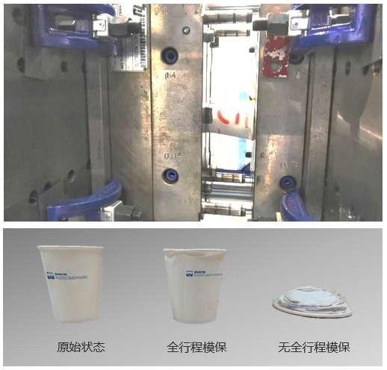
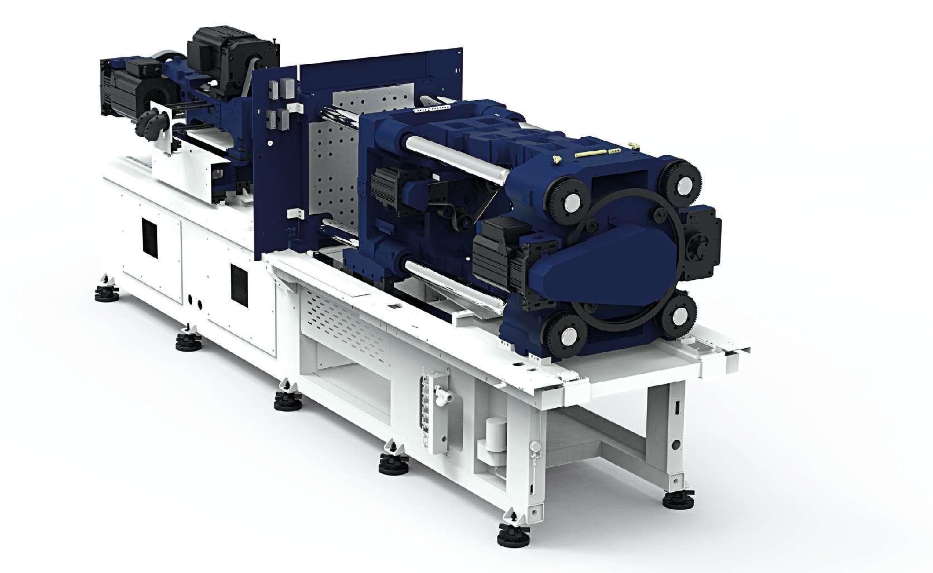
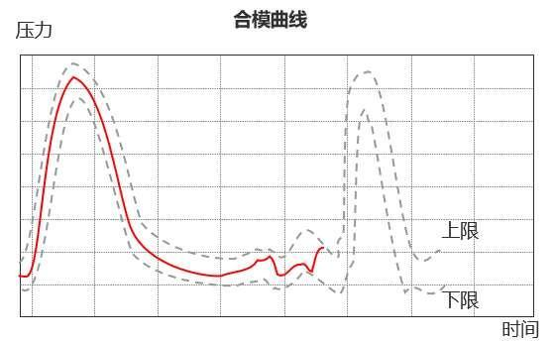
Clamping Unit
-HT mold protection
Intelligent full-process mold protection function upgrade.
Intelligent and highly sensitive active die protection that instantly detects small load deviations throughout the die closing stroke and minimizes mold protection response time.
Monitoring at all times
Monitor each molding cycle Servo motor load
Mold opening and closing
Servo motor
Detected anomaly
High precision detection of load changes caused by clamping of molded products
Protection
Immediately stop opening and closing mold and ejector rod forward and backward action

Slide 21
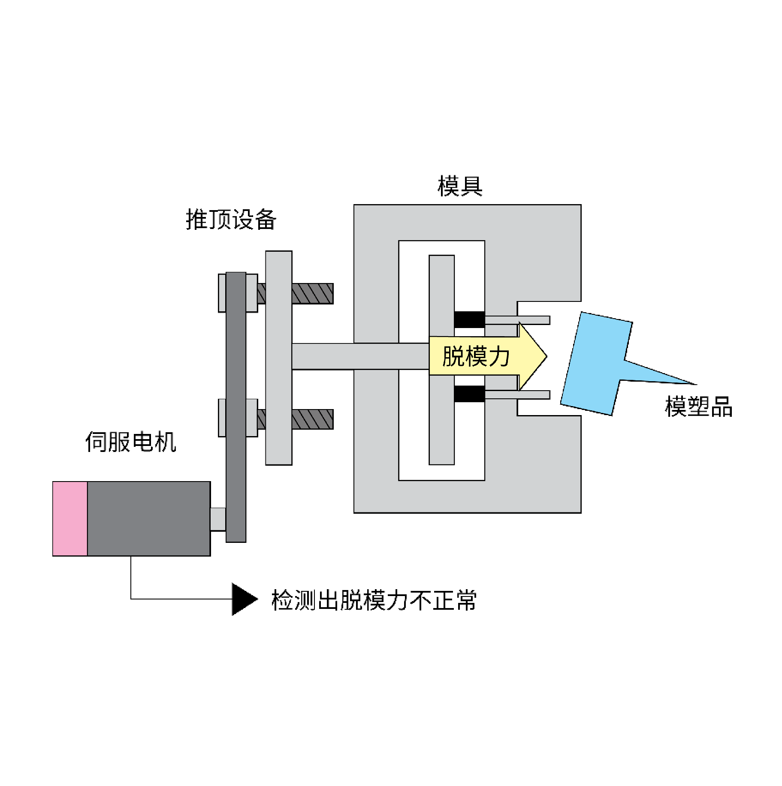
Clamping Unit
- Smart ejection （option）
The motor torque when the product is pushed is detected, and the push action will be stopped in an emergency when an anomaly is found. This function protects the ejector from damage and can be used to monitor the quality of the product.
Due to the adoption of high response servo motor and low inertia ejector mechanism, the ejector response speed of the 5th generation machine is significantly improved.

Slide 22
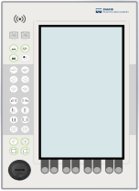

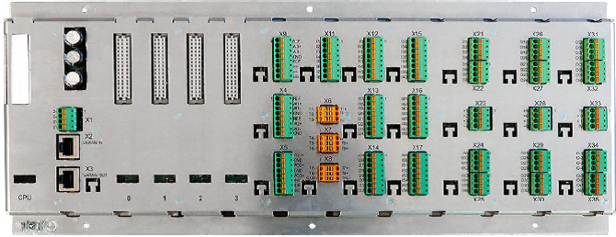
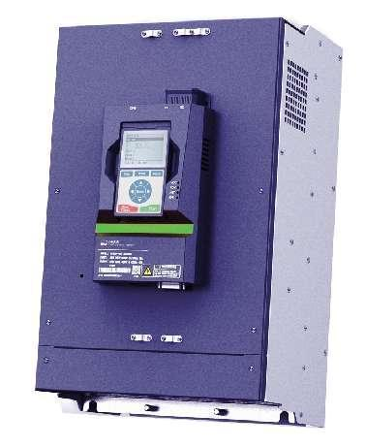

Smart Technology
- The control system is continuously upgraded
New control architecture
OPTION
Using distributed multi-CPU control architecture, the system's computing power is greatly improved, and it has good expansion ability
The new communication protocol makes it possible to further improve the control computing power and control the sampling frequency, which is the basic guarantee of ultra-high precision molding.
The newly developed servo control card not only further improves the control accuracy, but also enricheth many intelligent functions.

Slide 23
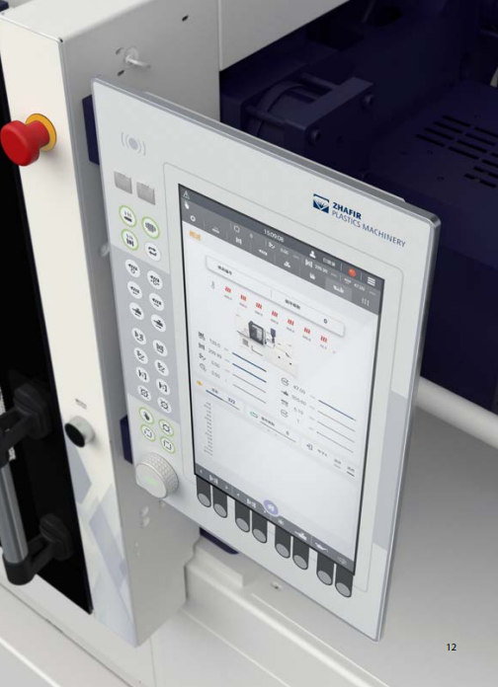
Smart Technology
- The control system is continuously upgraded
New human-machine interaction screen
The display screen is equipped with a 15-inch ultra-high resolution true color display, and the touch capacitive screen is equipped with an independent image processing CPU, which makes the man-machine interface control more clear and smooth, and the operation experience is greatly improved.
The new user-friendly page is intuitive and easy to learn, even for first-time users.
The new shuttle knob design allows page and parameter operation through the shuttle
The vertical design of the new screen makes the setting area and the monitoring area clearly distributed for easy observation.
The buttons of the configuration design make it easy for customers to customize the function of the key arrangement.

Slide 24
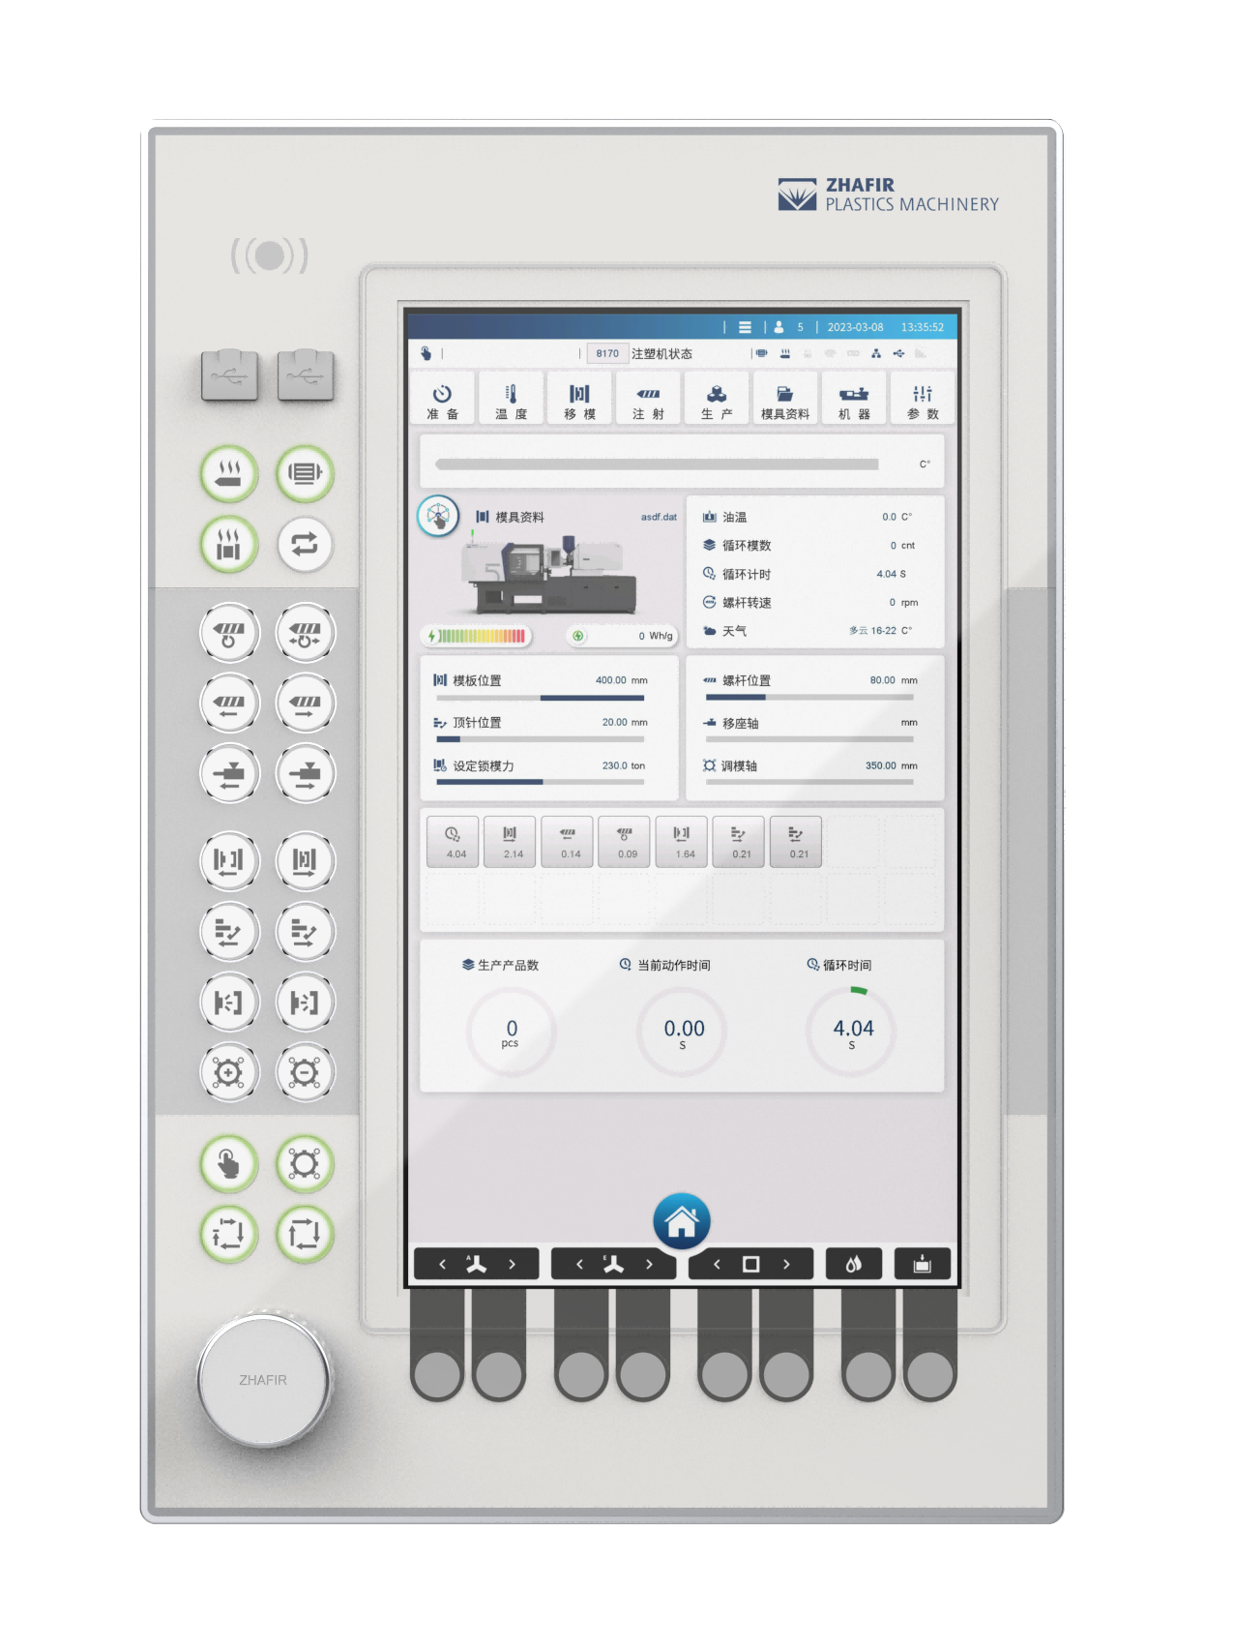
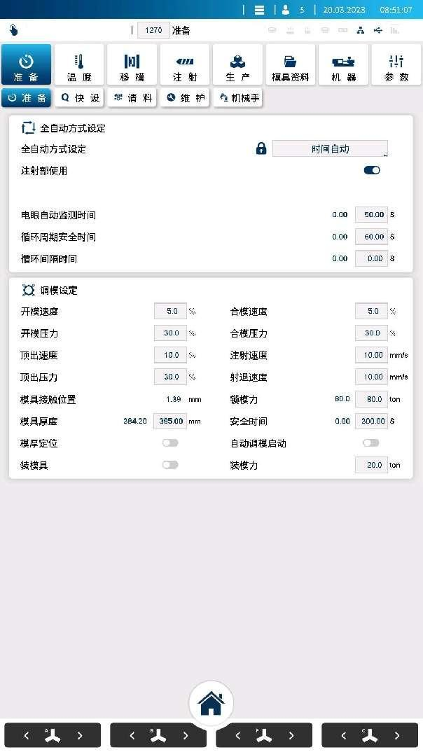

Smart Technology
-The control system is continuously upgraded
Convenient and intelligent operation screen
Production preparation
Equipped with the function of fast mold loading, just follow the mold installation steps in the picture, you can achieve fast and accurate mold installation and mold locking force adjustment.
The easy-to-understand ICONS continue the main visual image of the previous generation of products
Quick setup screen After the mold installation is completed, all the basic process parameters can be set in a quick screen.

Slide 25



Smart Technology
- Controller performance continues to evolve
Injection acceleration and pressure response:
Filling stage: a variety of injection acceleration and deceleration modes are available ;
Pressure holding stage: Multiple pressure response modes are available. To adapt to a variety of characteristics of the molding process requirements, to achieve excellent stability
Injection stability greatly improved:
The all-round improvement of the fifth-generation control technology and the adoption of intelligent functions such as precision measurement have significantly improved the repeatability of the machine forming.
0.16mm
原来的控制技术
0.05mm
五代控制技术
Residual fluctuation range

Slide 26





Smart Technology
HT injection （option）
Improving weight stability of injection molded products
Some disturbance factors in the injection filling process are controlled in real time to achieve the weight stability control goal of the injection product
Mechanical control output
HT injection
HT Injection off
HT Injection on
未开
灵智注射
开
灵智注射
Product Weight/g
Holding Pressure
Data processing
Pressure
Quality mean: 338.12
Key Algorithm
Quality mean: 337.57
Quality variance: 1.00261
Quality variance : 0.59268
Time
Cycle
Notes:
显示7个动作的每模能耗和近10模驱动总能耗显示

Slide 27



Smart Technology
- HT injection(option)
The function of intelligent clamping force adjustment, combined with simulation means, fits the response curve function, and intelligently matches the real clamping force required by different product production.
It can automatically detect the minimum clamping force that can make the parting surface of the mold completely fit, which can greatly reduce the clamping force, reduce energy consumption and improve the service life of the mold.
传感器
检测与反馈
控制
计算
单元
如波形A所示，注塑压力为峰值时，即使锁模力上升，但如果在保压工序中锁模力降低至设定值，便可判断锁模力的设定值是足够了。
参数
调节
输入

Slide 28

HT Energy consumption management 2.0
Intelligent energy consumption analysis function without increasing the detection hardware, can use driver detection, electric heating power duty ratio analysis and standby energy consumption calculation and other functions to achieve accurate energy consumption estimation.
With statistical analysis of energy consumption, abnormal reminder and other functions.

Slide 29











Smart Technology
-HT integration
As the core of automated production, the forming machine realizes the interconnection with the peripheral equipment
Through bus or other communication interface, realize the centralized control of peripheral equipment. The peripheral equipment can be easily observed and operated on the injection molding machine, so that the injection molding machine truly becomes the center of the entire molding system.
BUS

Slide 30


HT integration
Through the powerful information technology capability and the connection of global factories, the operation status of each injection molding machine in all factories in the world can be mastered in the central war situation control room.

Slide 31

谢谢！

